Slide 1
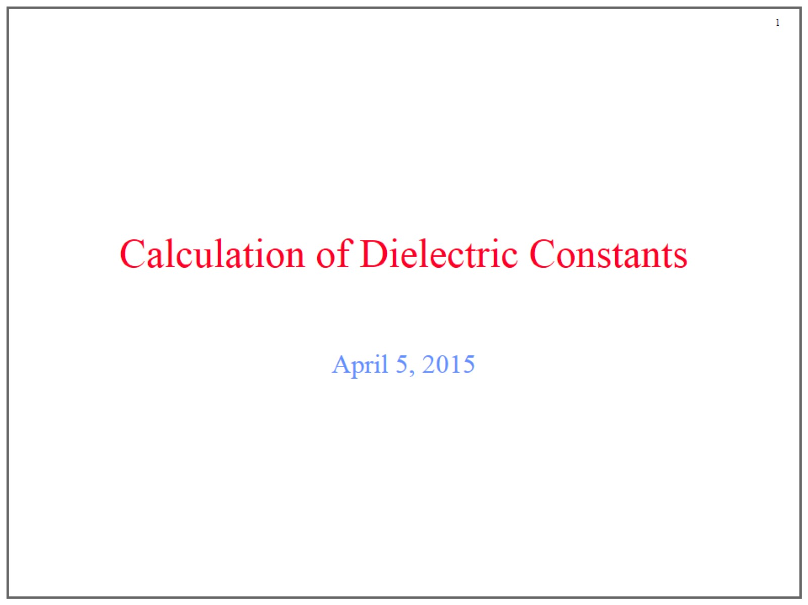
Calculation of Dielectric Constants

Slide 2
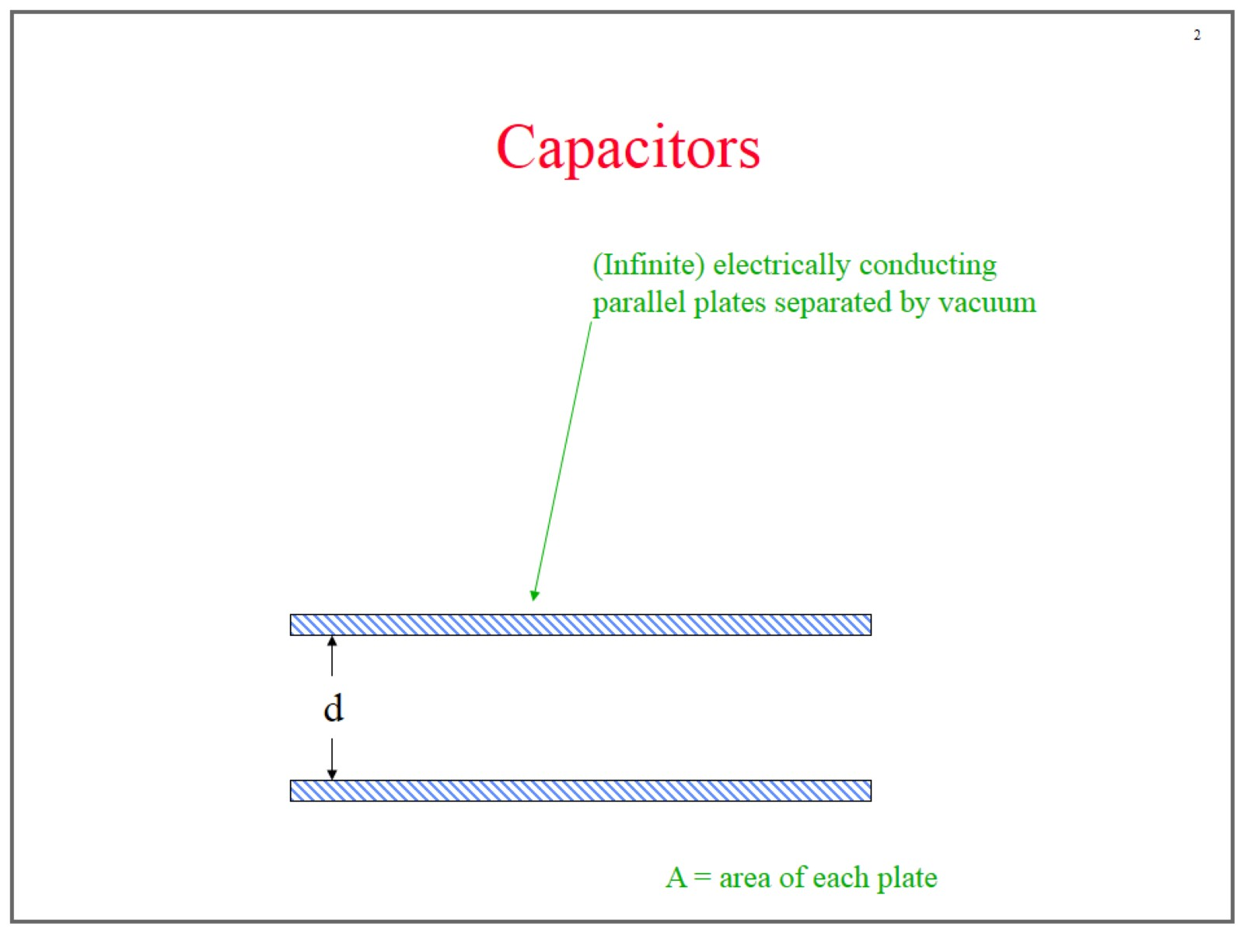
Capacitors

Slide 3
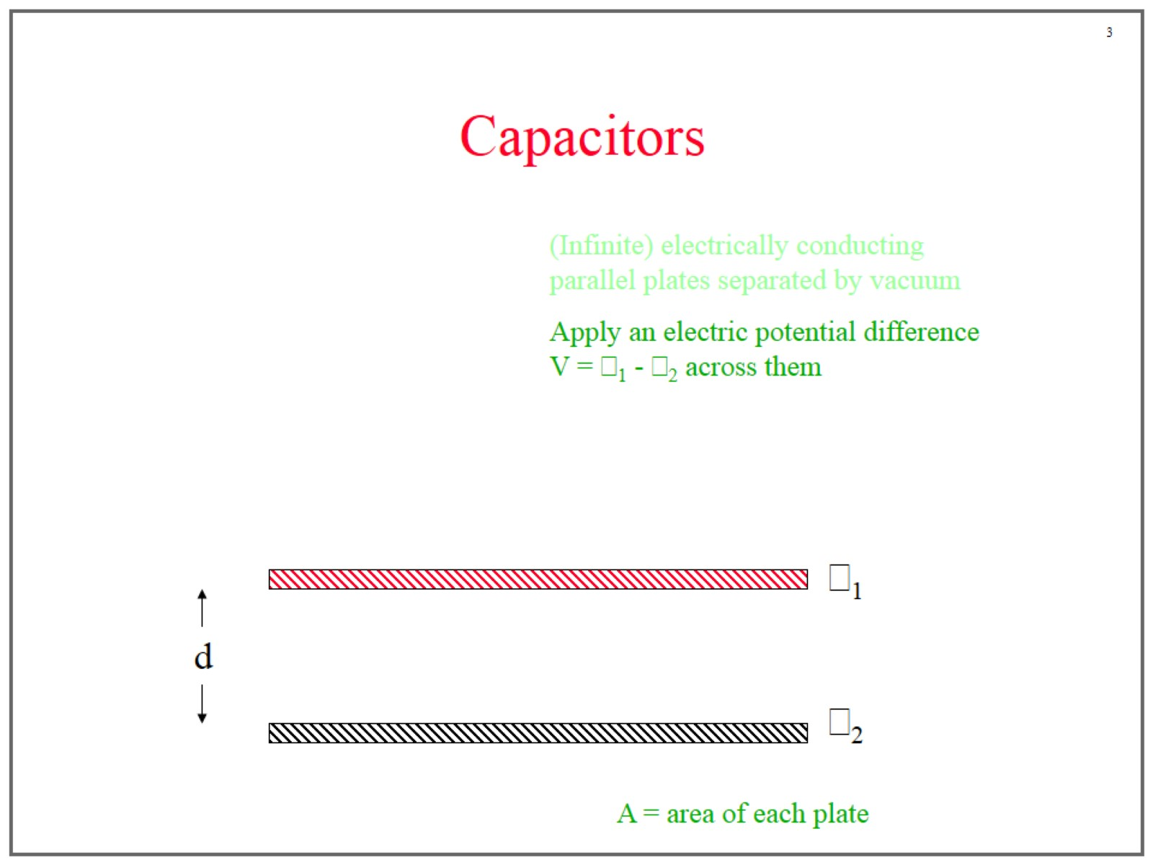
Capacitors

Slide 4
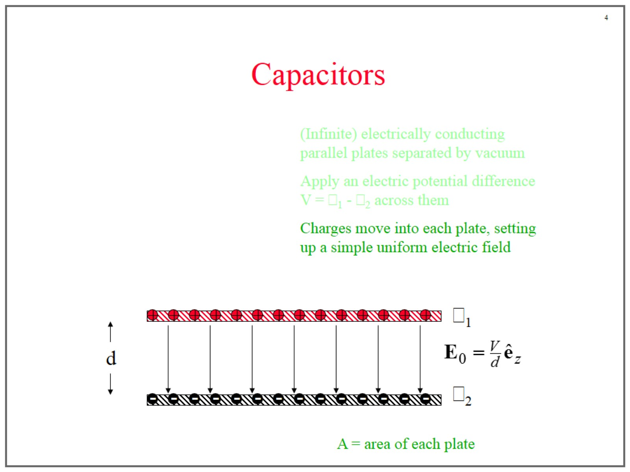
Capacitors

Slide 5
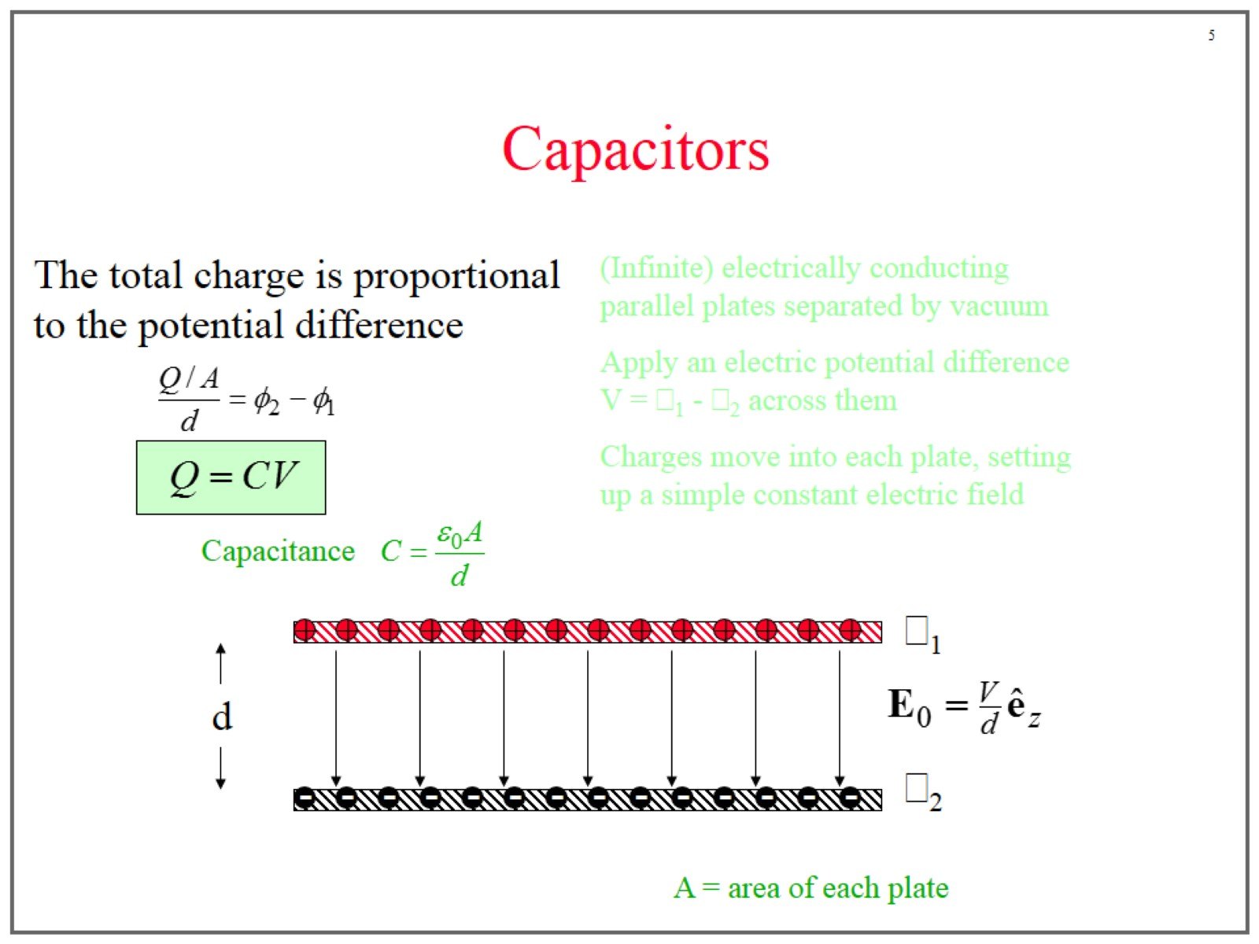
Capacitors

Slide 6
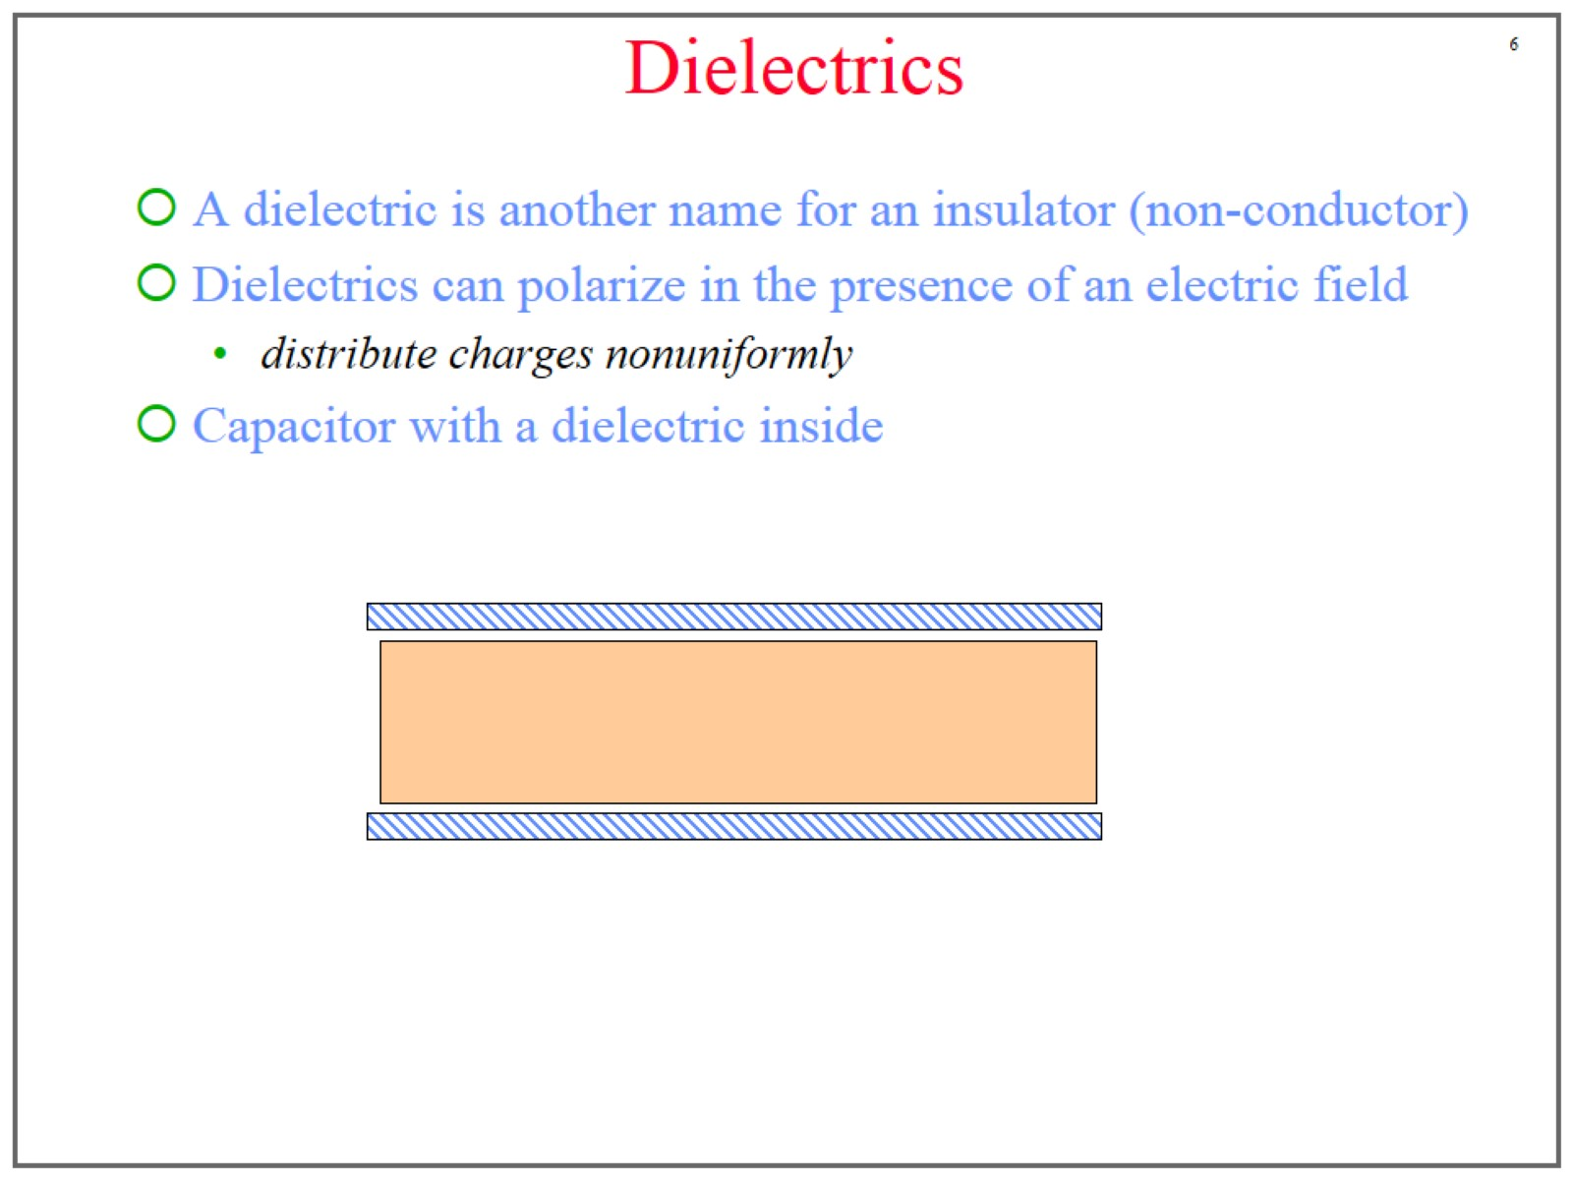
Dielectrics

Slide 7
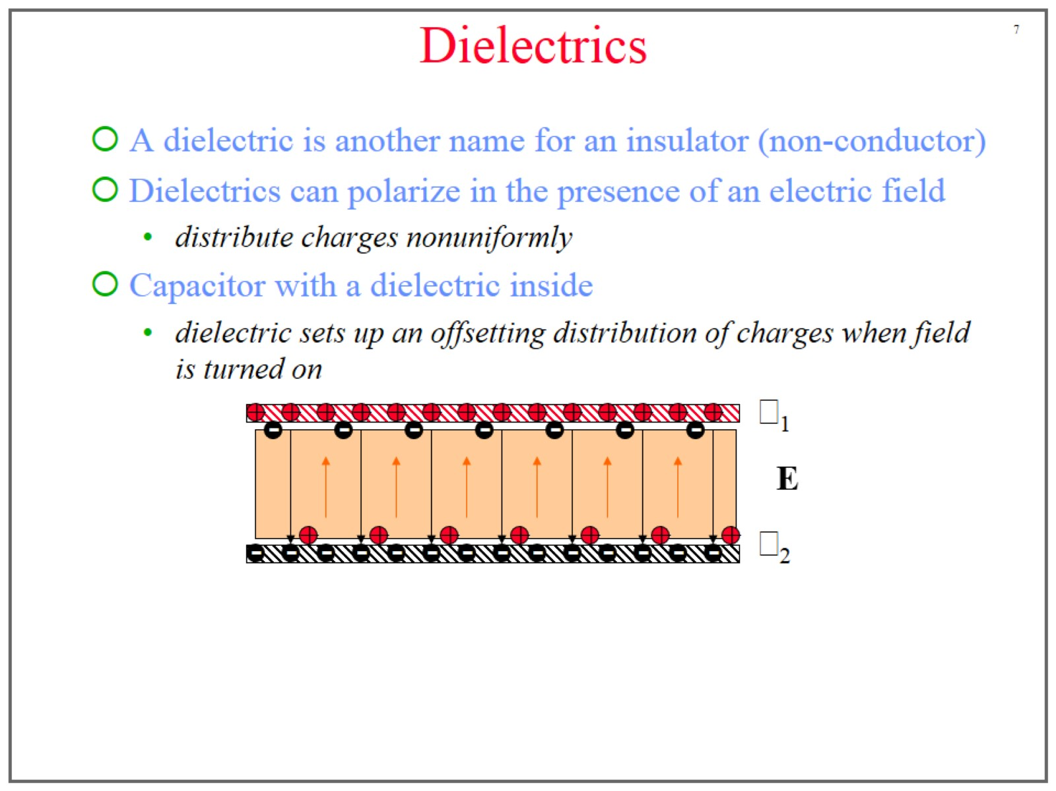
Dielectrics

Slide 8
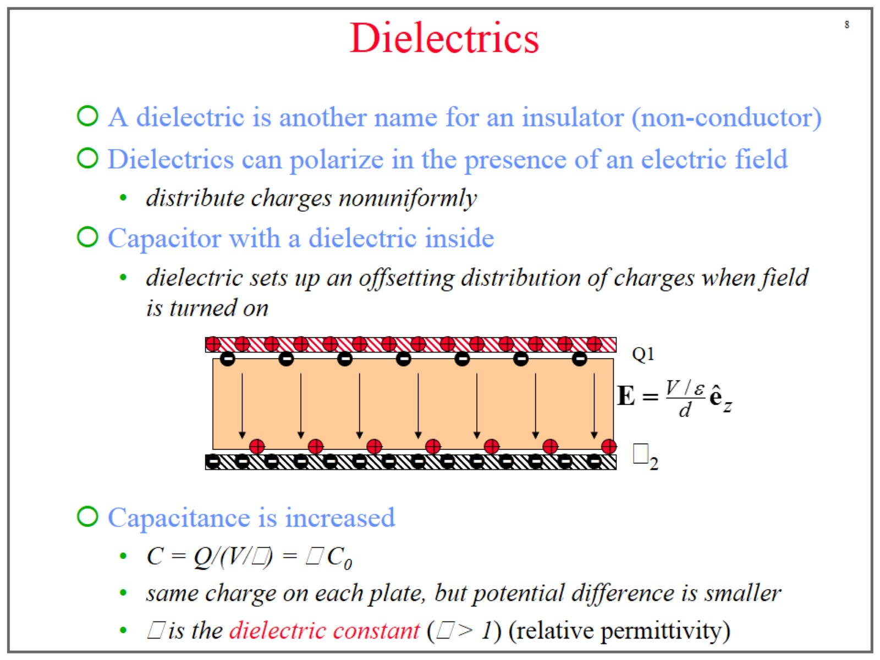
Dielectrics

Slide 9
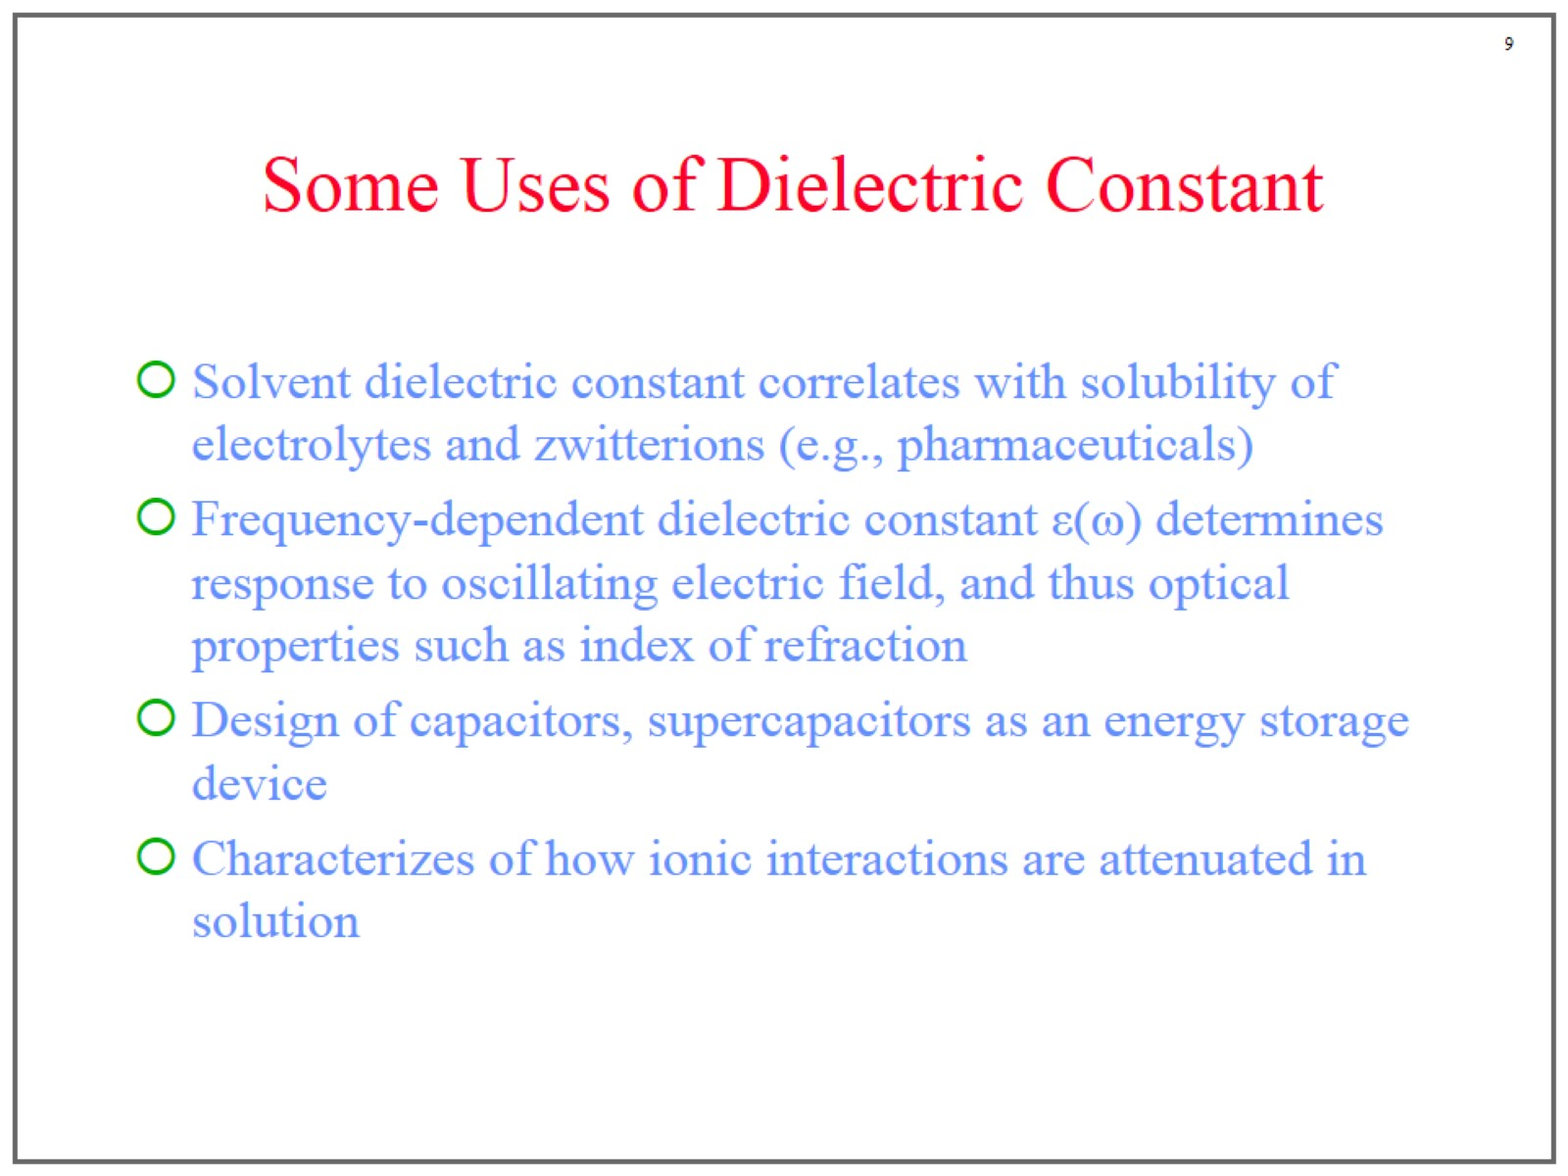
Some Uses of Dielectric Constant

Slide 10
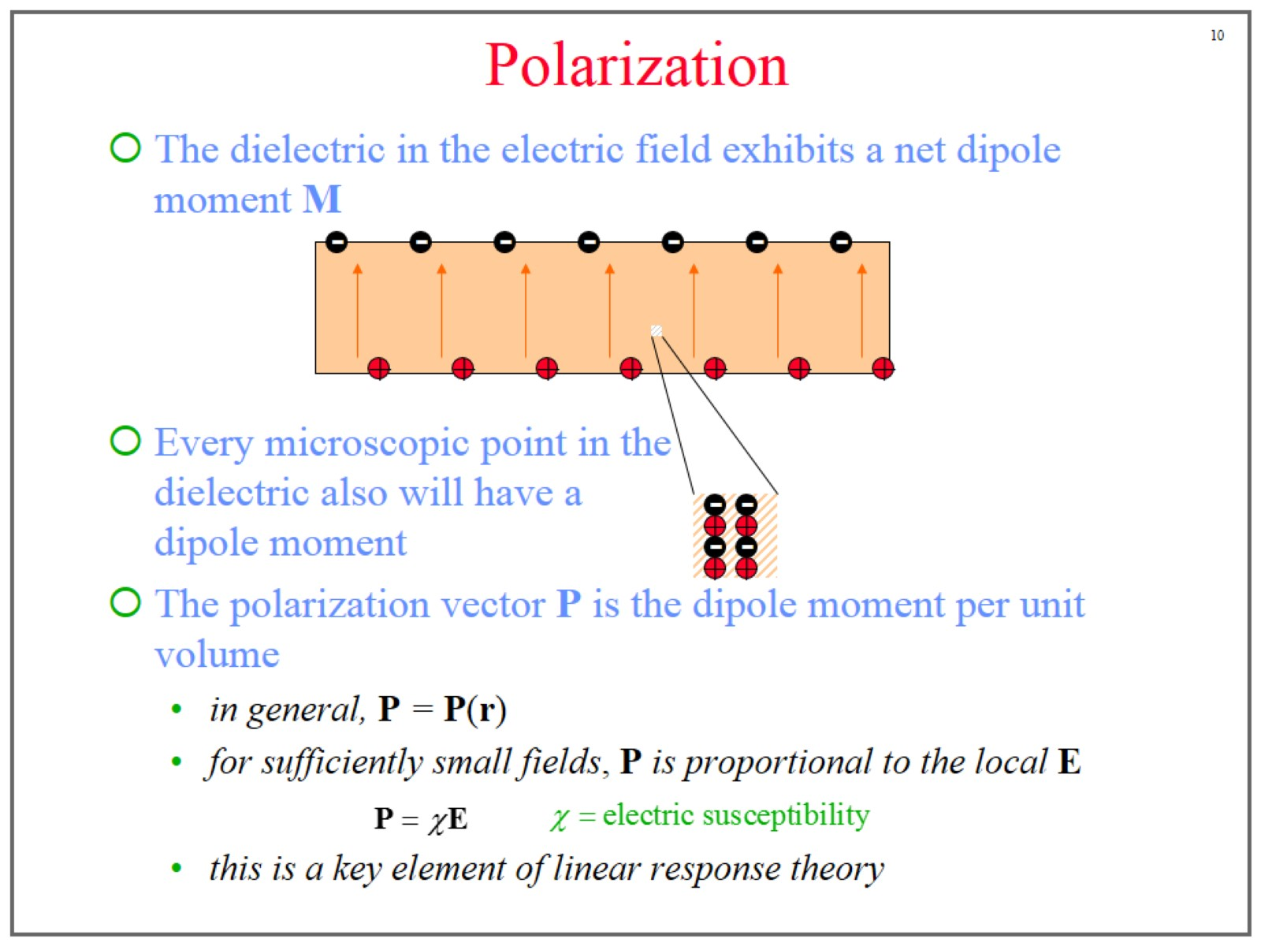
Polarization

Slide 11
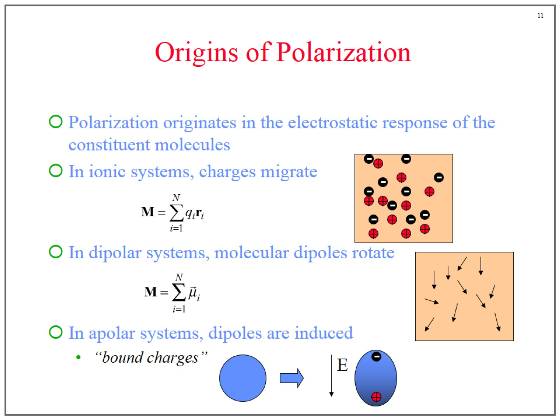
Origins of Polarization

Slide 12
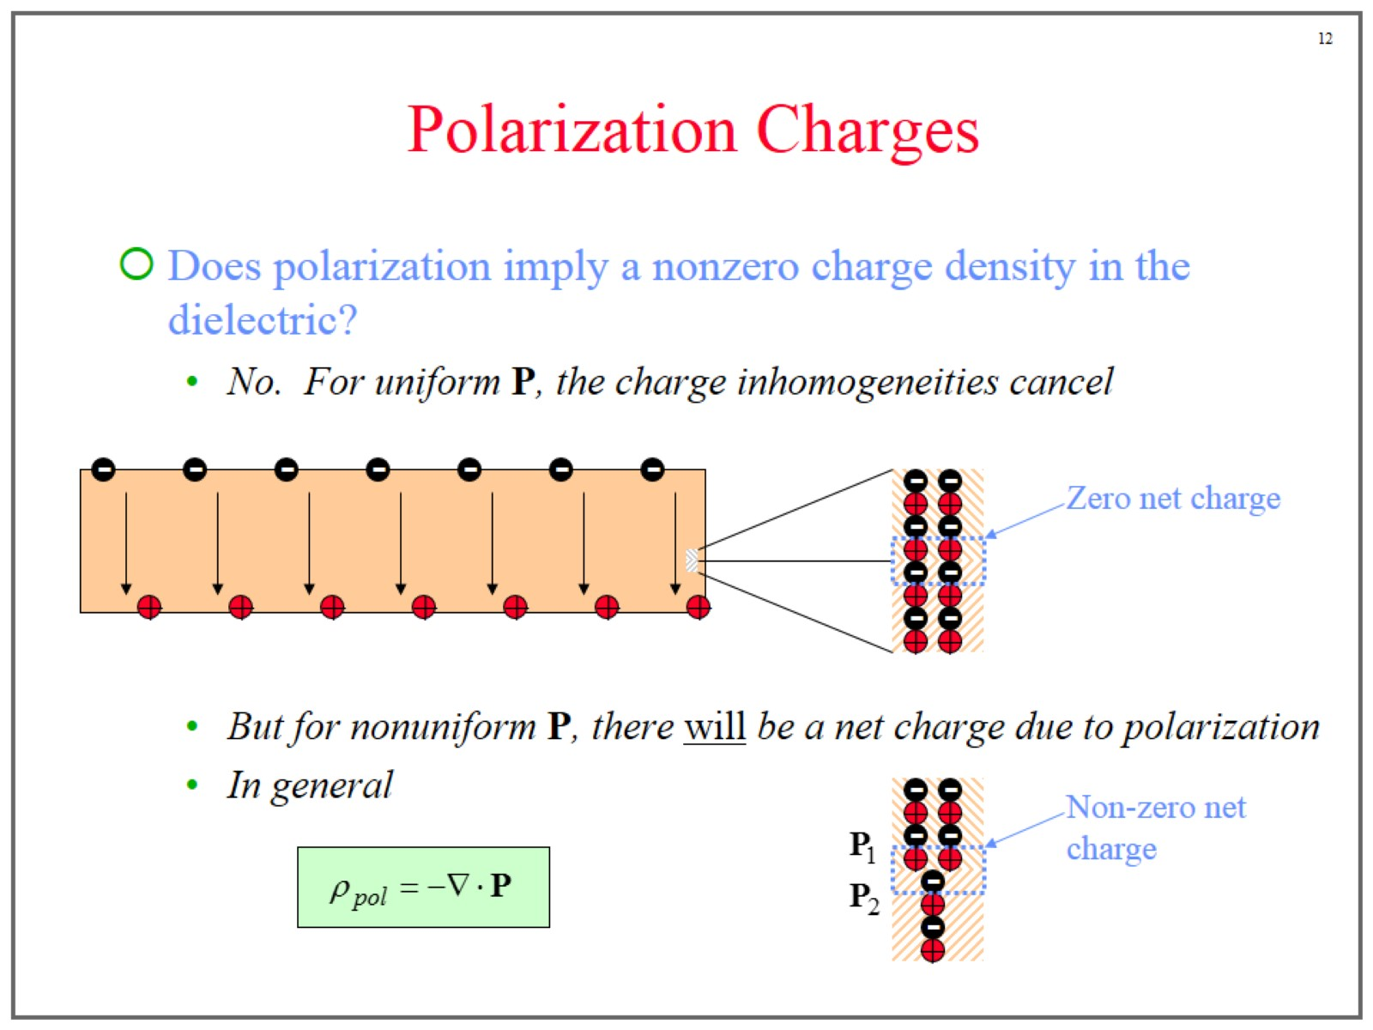
Polarization Charges

Slide 13
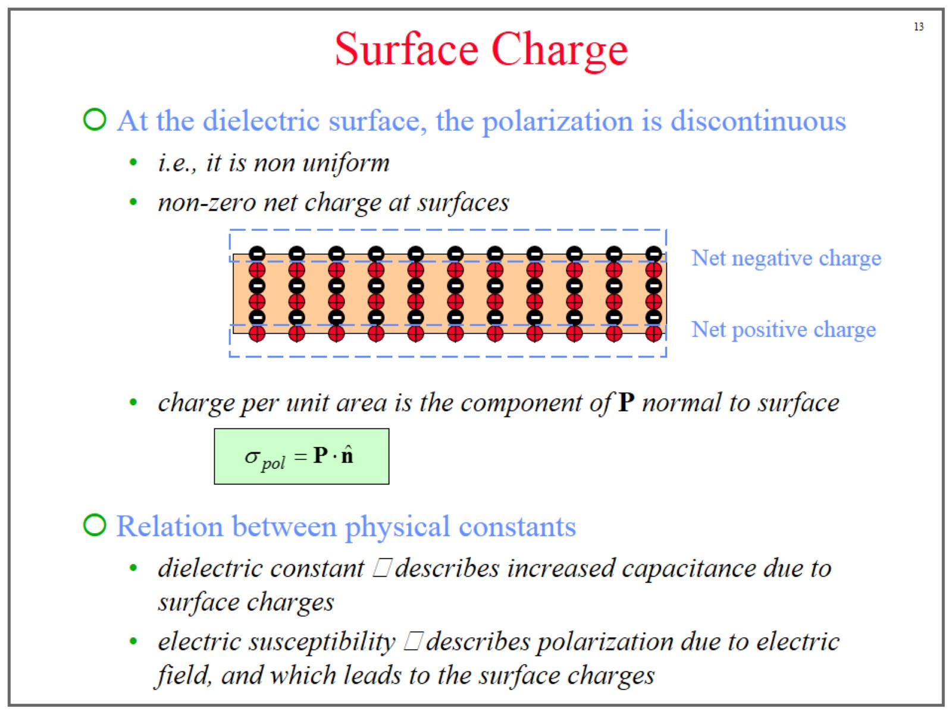
Surface Charge

Slide 14
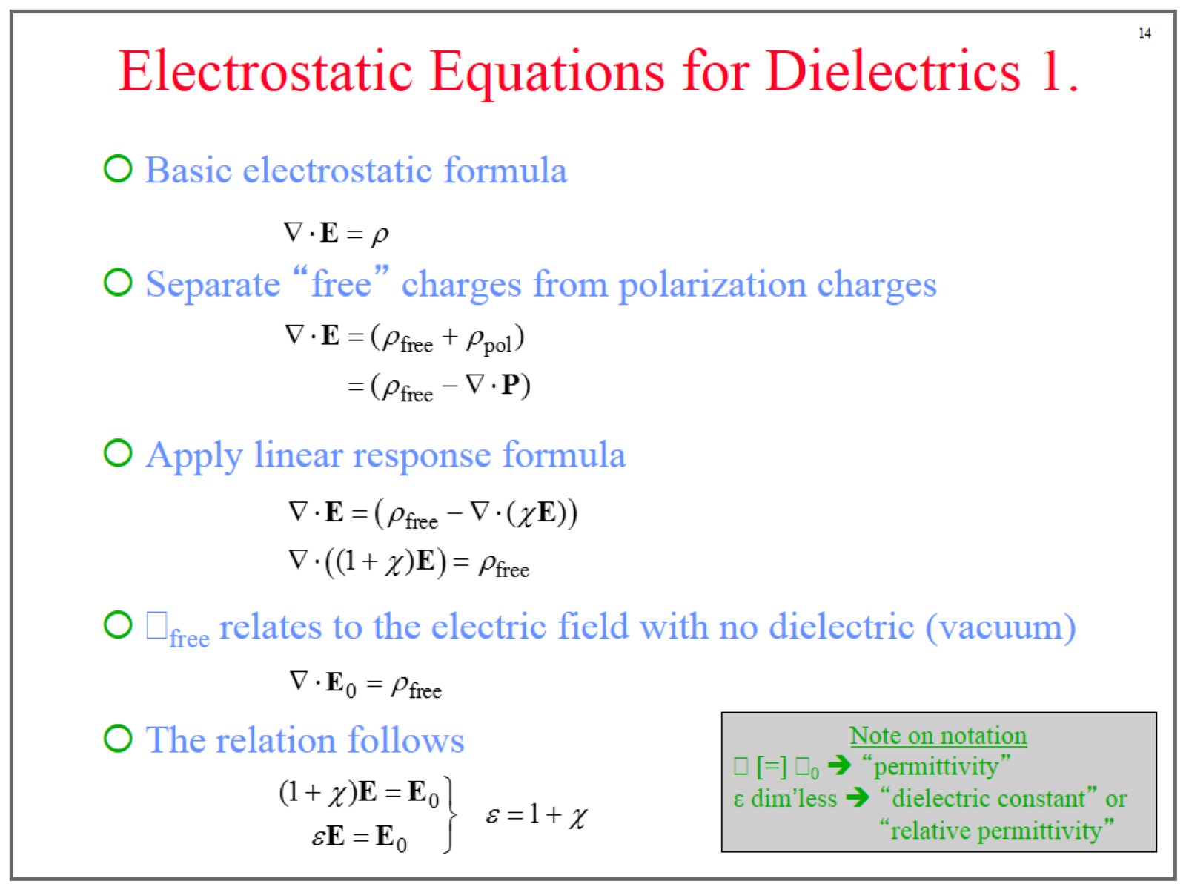
Electrostatic Equations for Dielectrics 1.

Slide 15
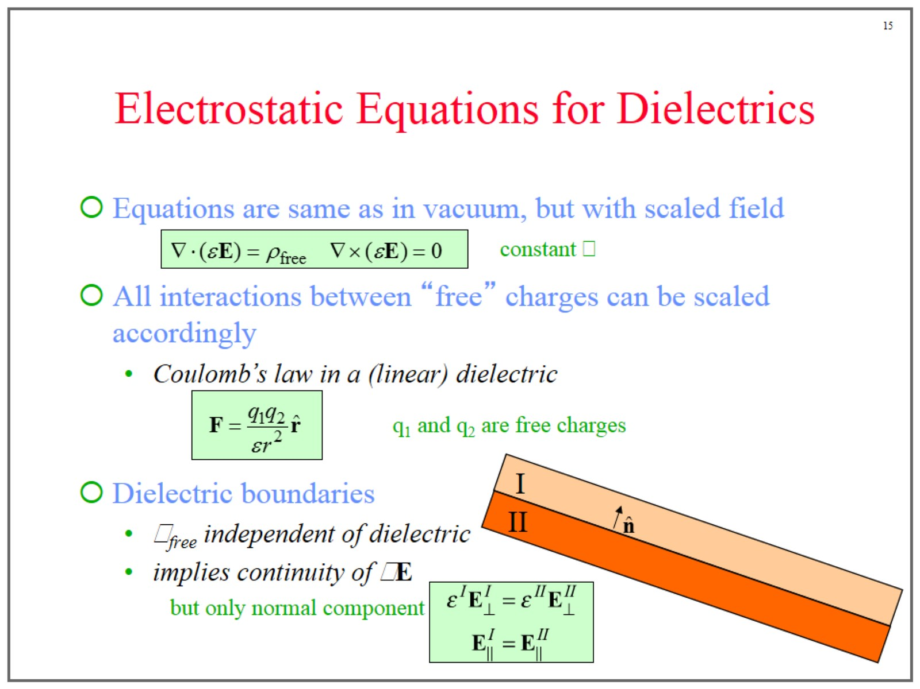
Electrostatic Equations for Dielectrics

Slide 16
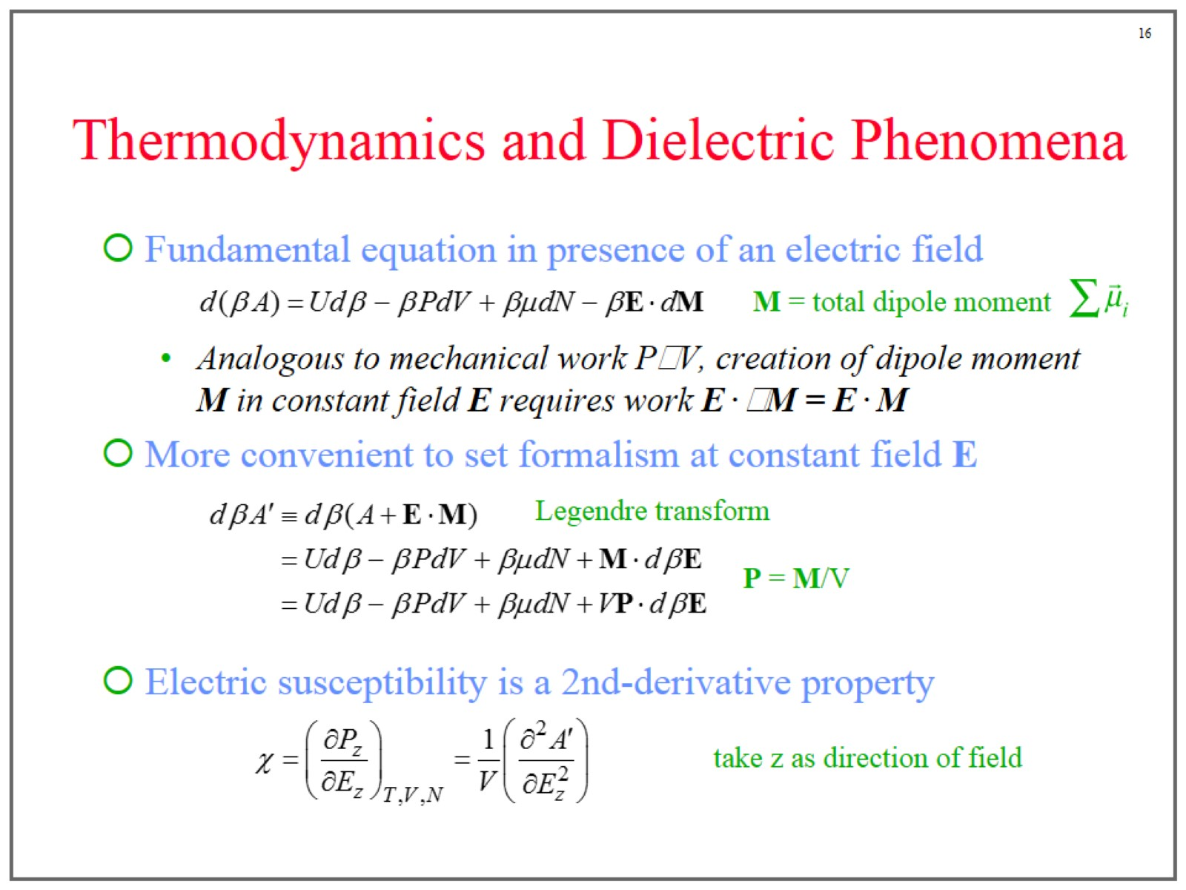
Thermodynamics and Dielectric Phenomena

Slide 17
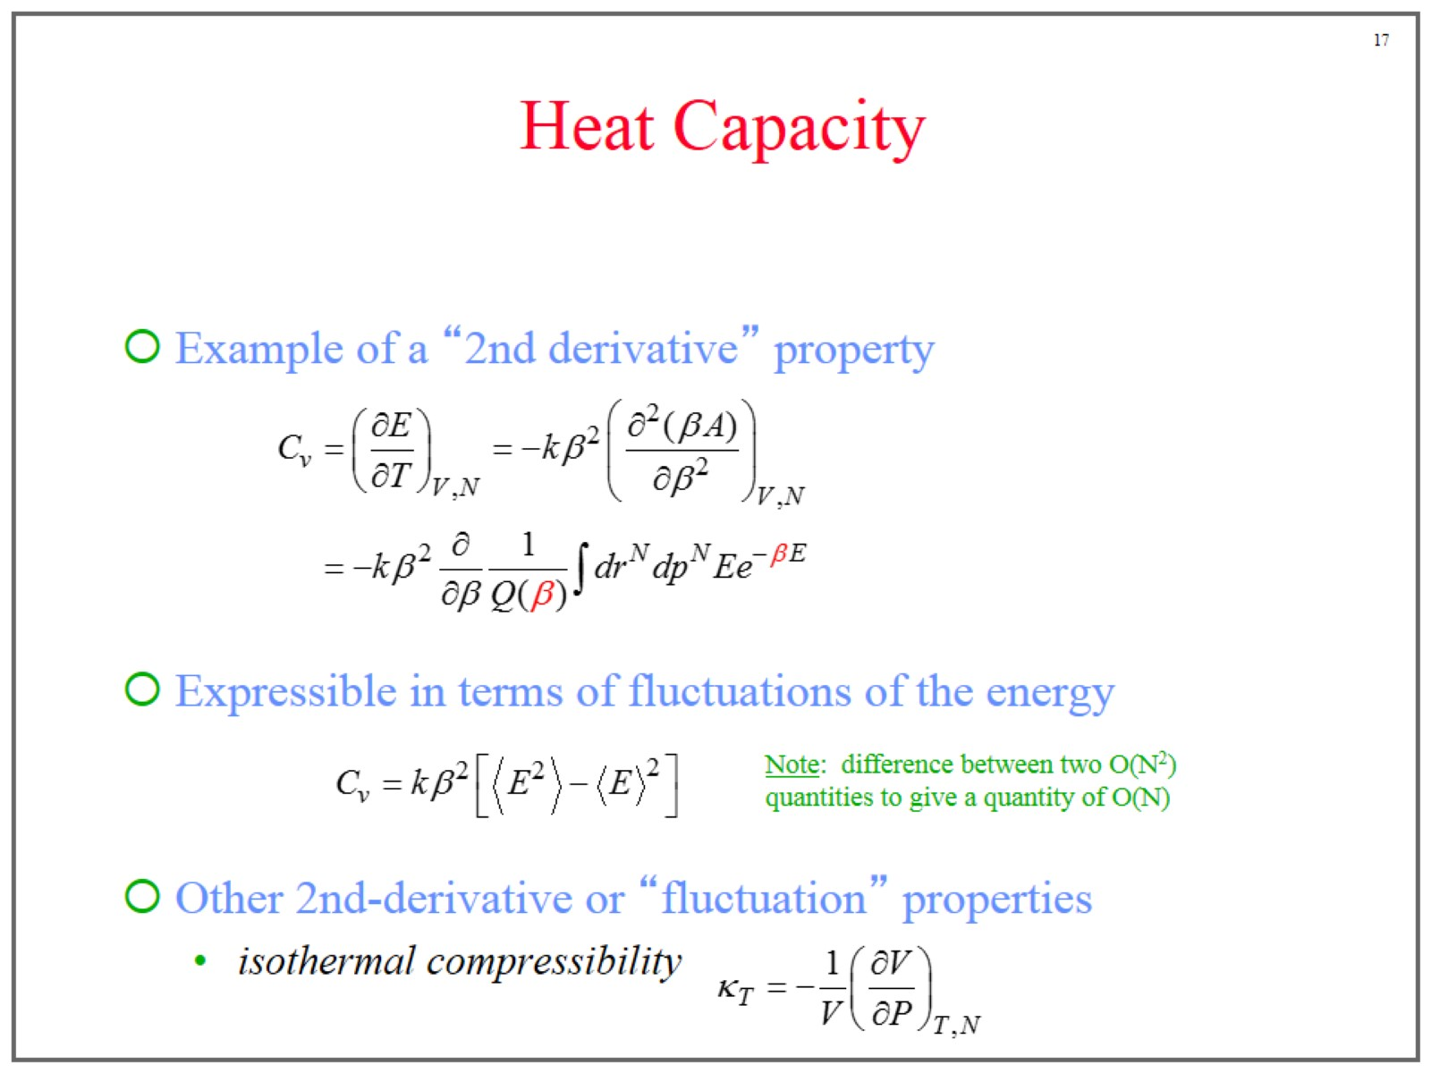
Heat Capacity

Slide 18
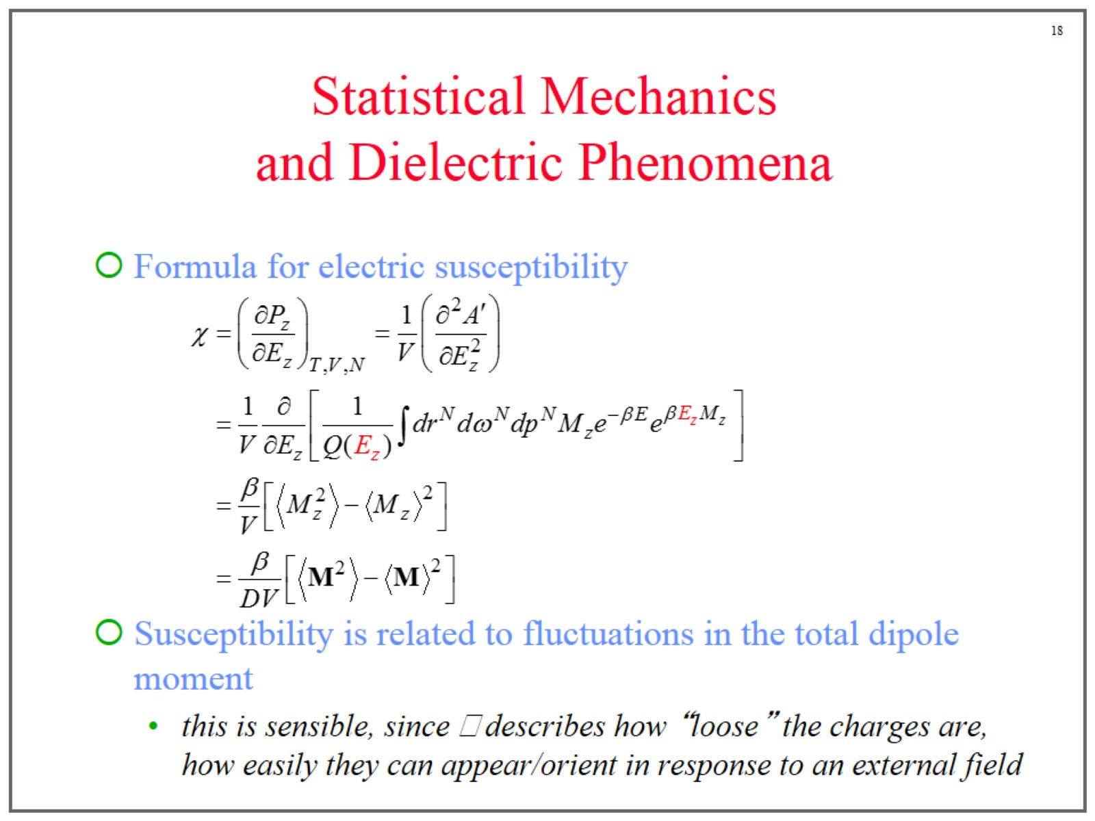
Statistical Mechanics and Dielectric Phenomena

Slide 19
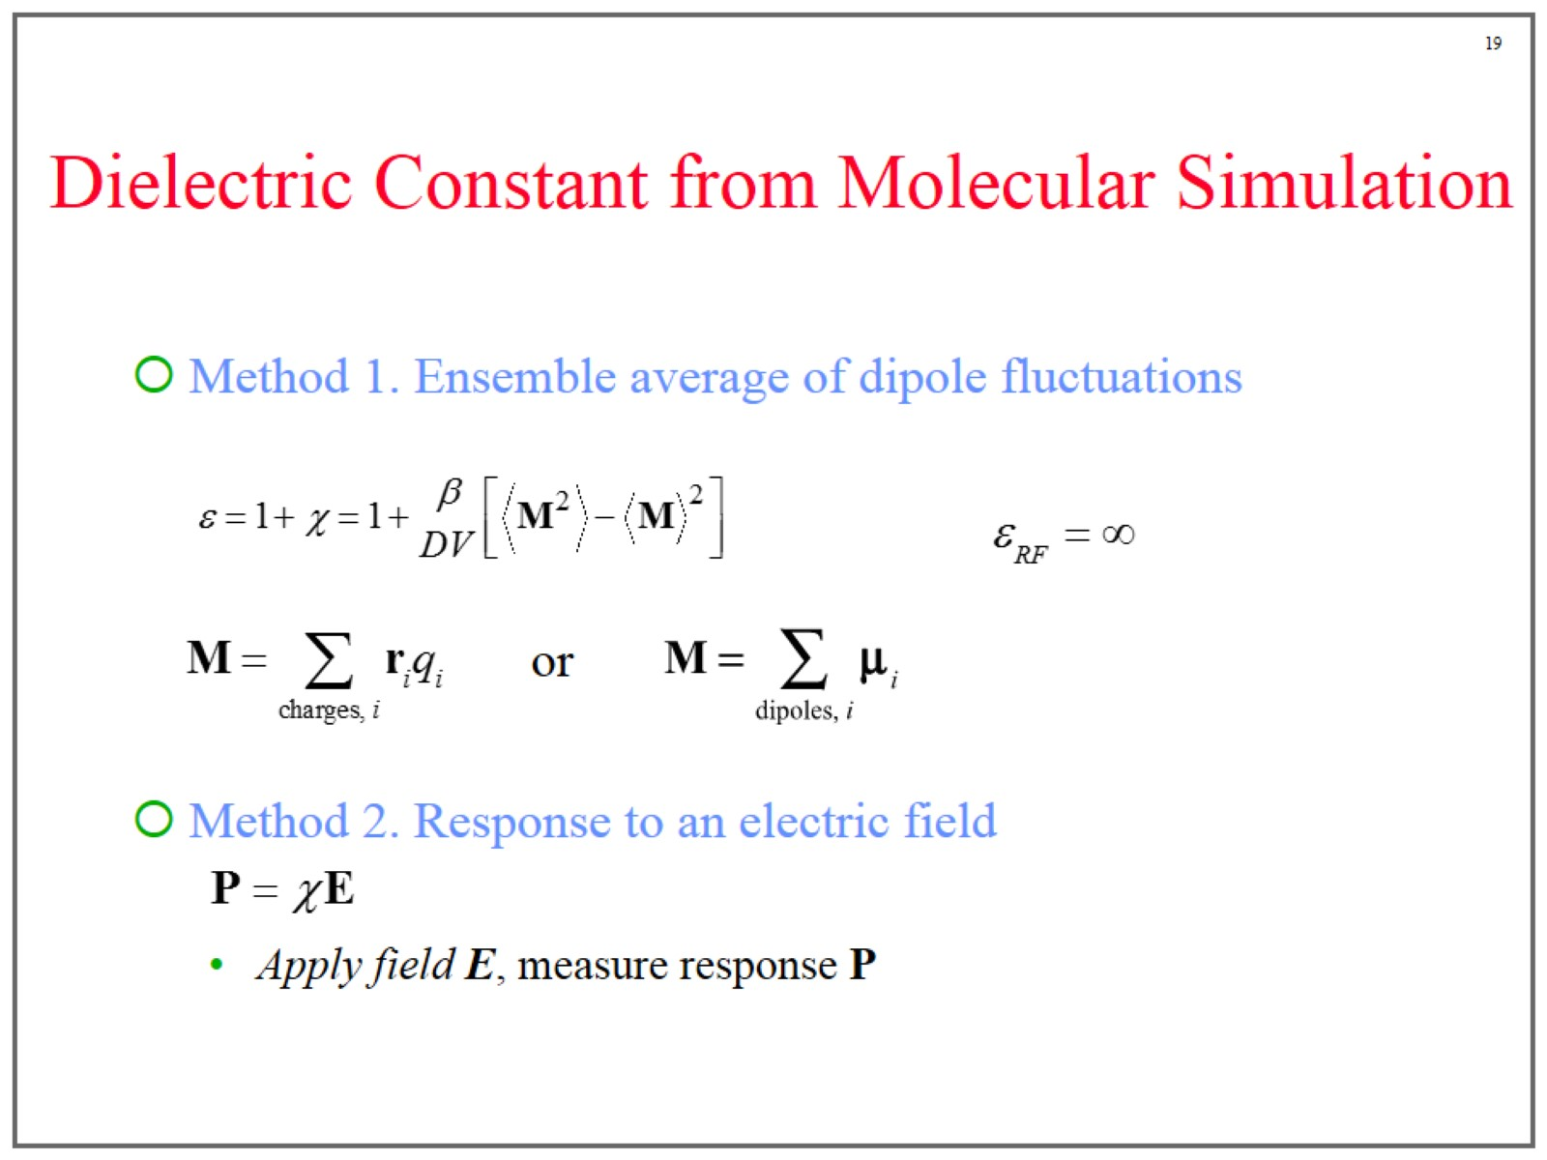
Dielectric Constant from Molecular Simulation

Slide 20
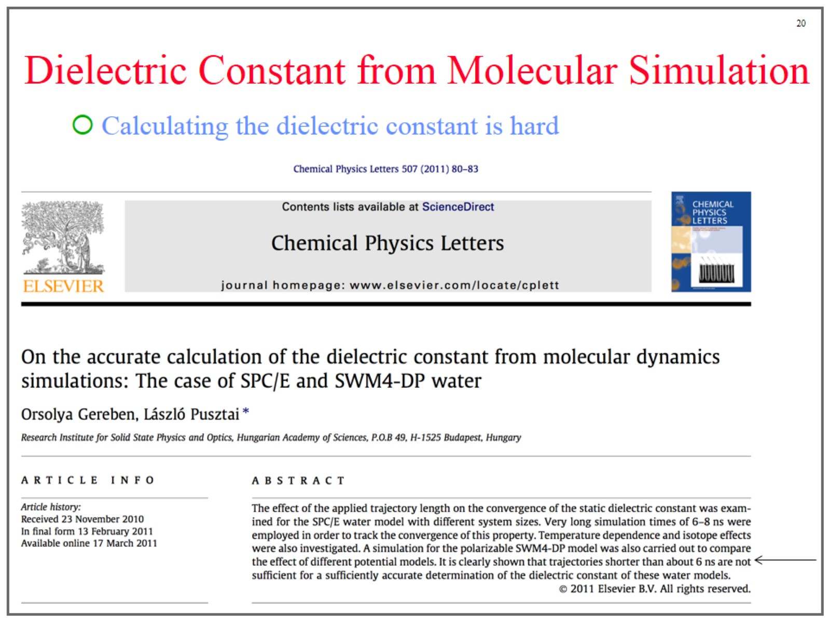
Dielectric Constant from Molecular Simulation

Slide 21
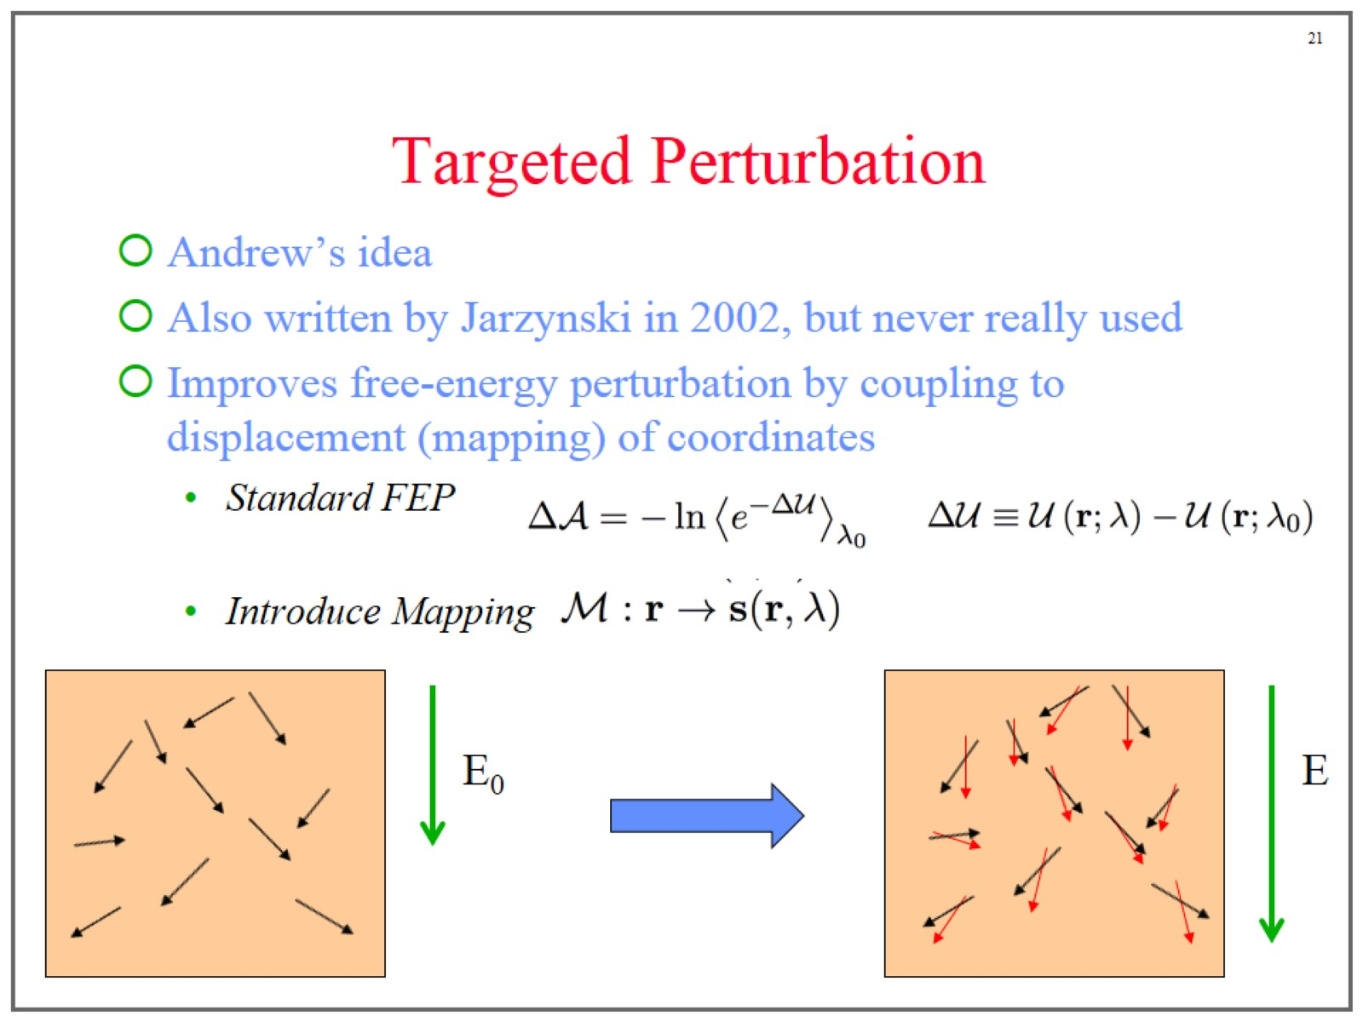
Targeted Perturbation

Slide 22
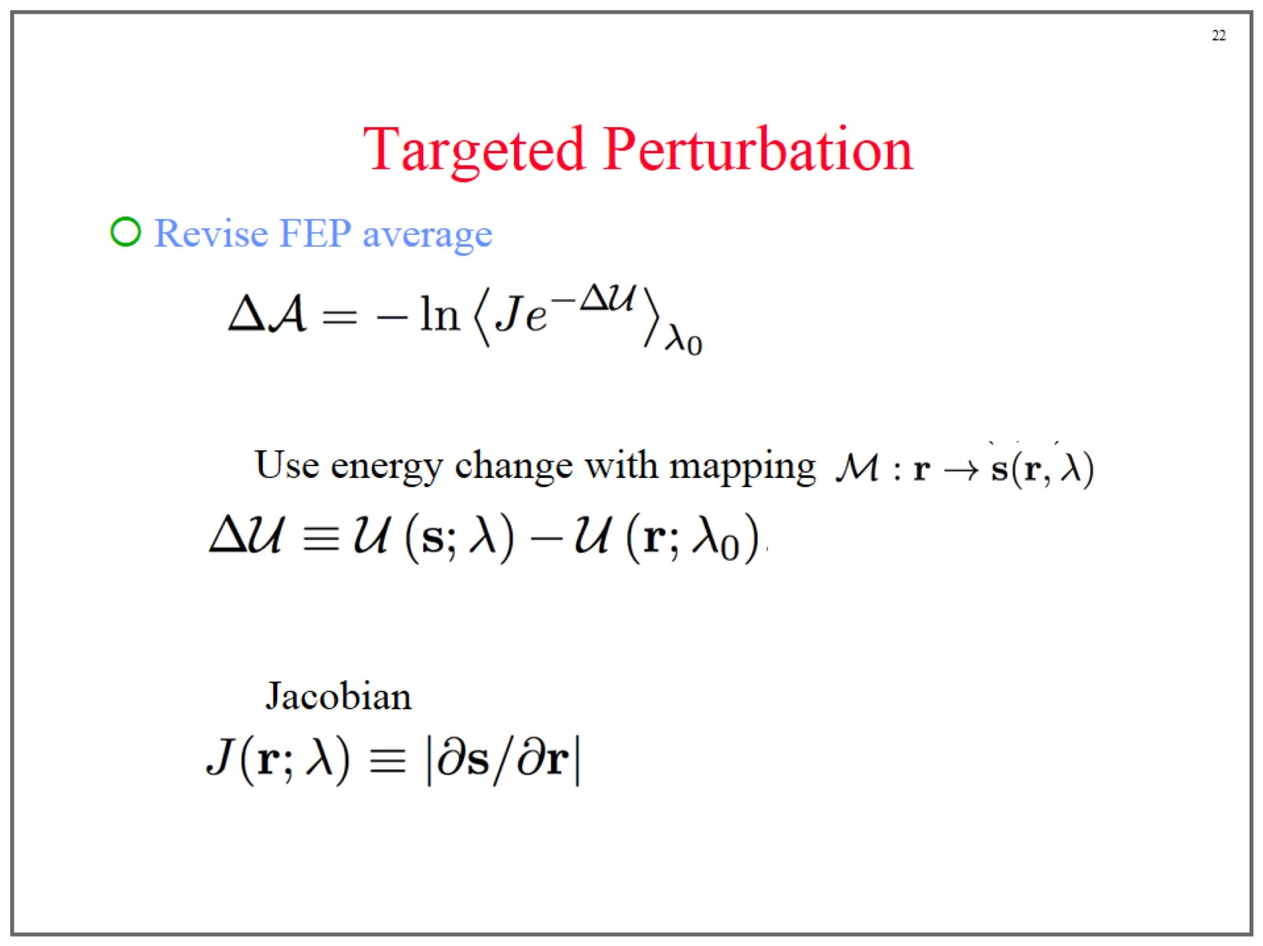
Targeted Perturbation

Slide 23
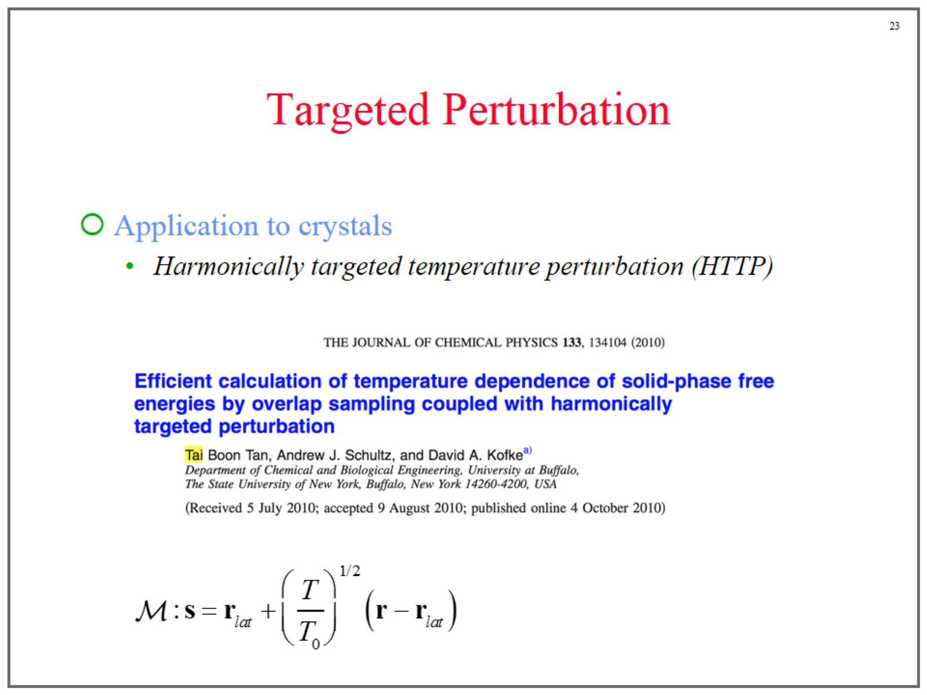
Targeted Perturbation

Slide 24
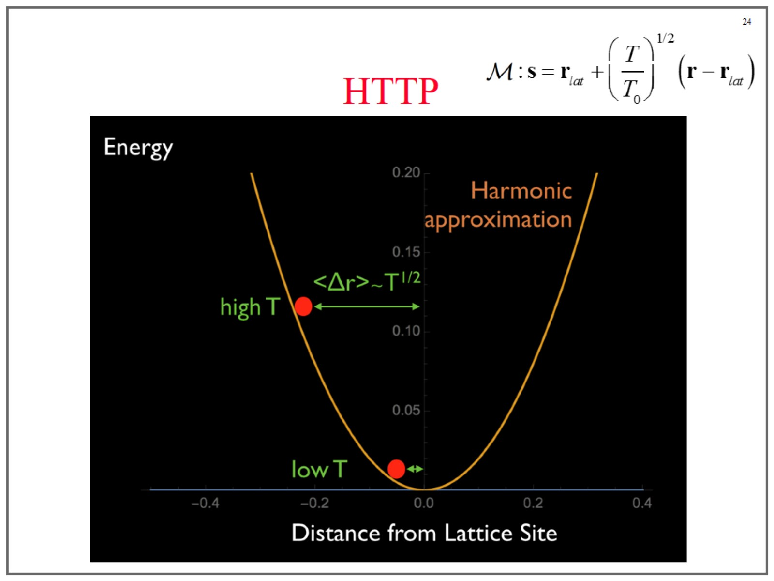
HTTP

Slide 25
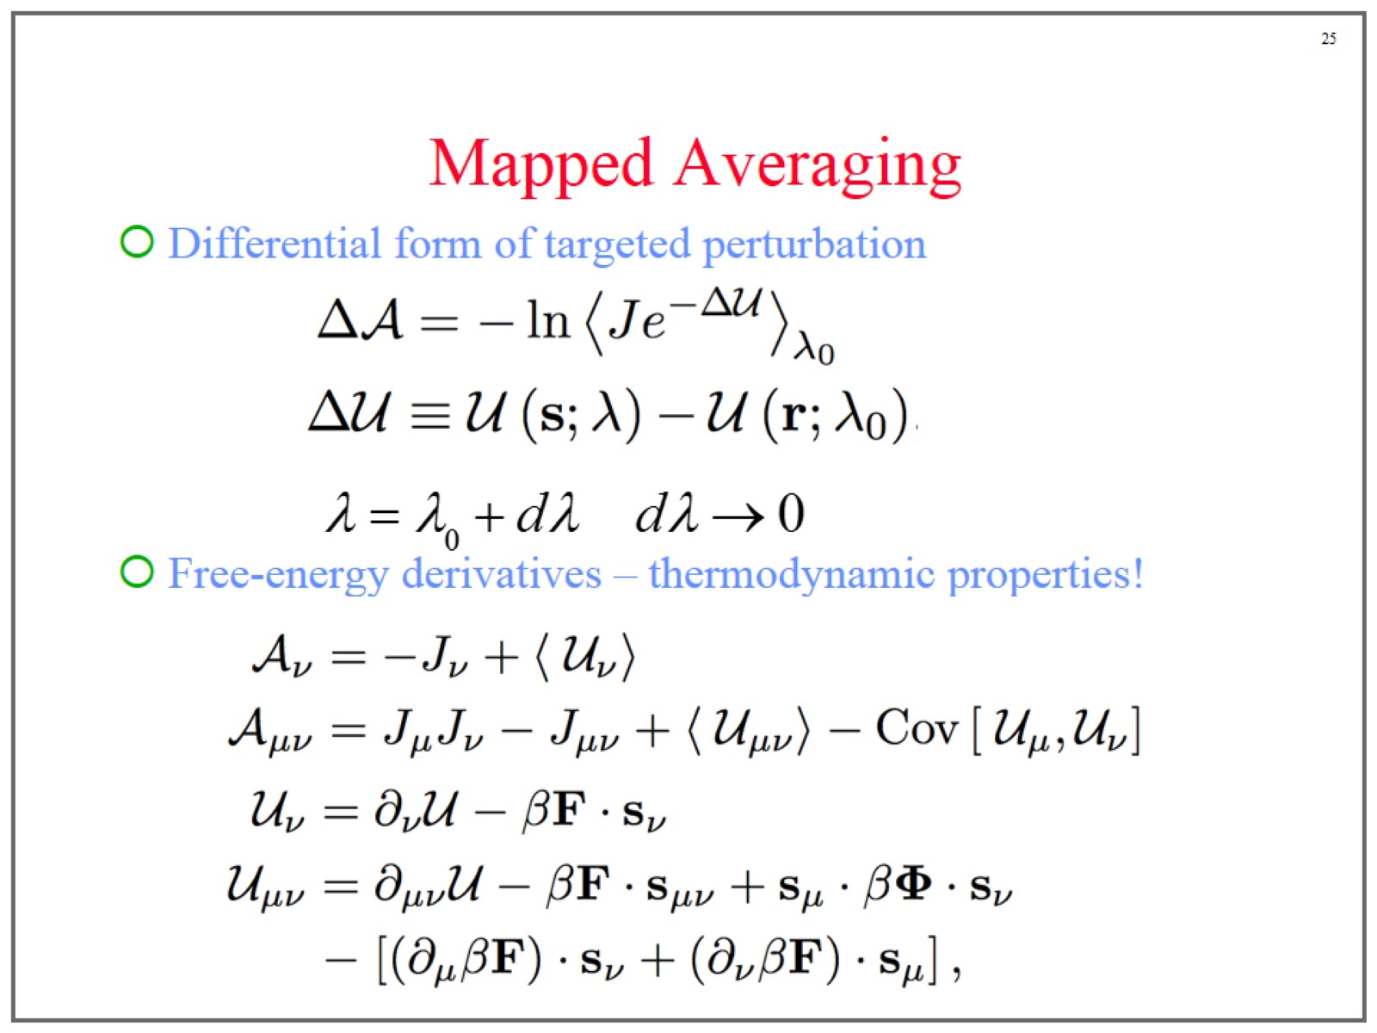
Mapped Averaging

Slide 26
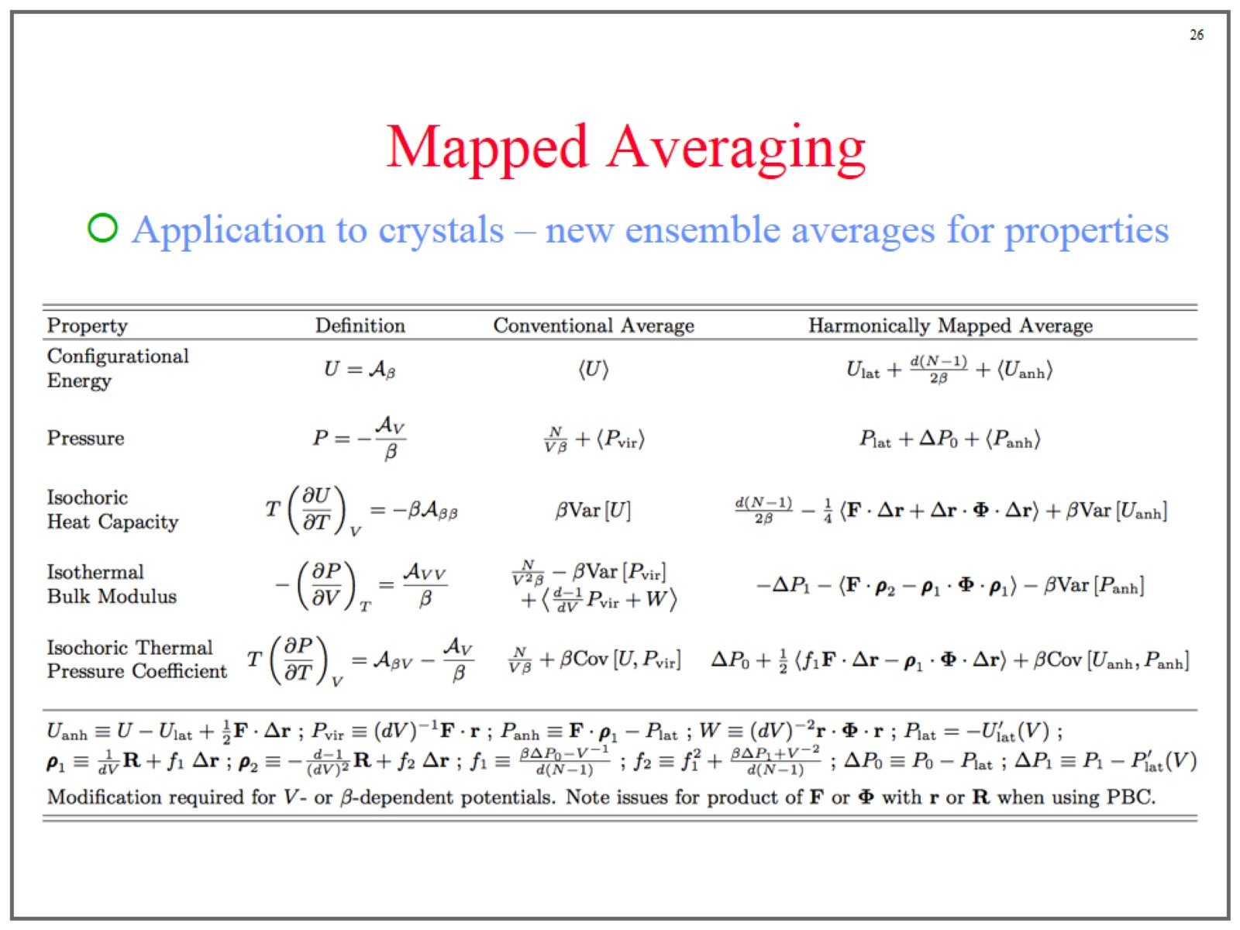
Mapped Averaging

Slide 27
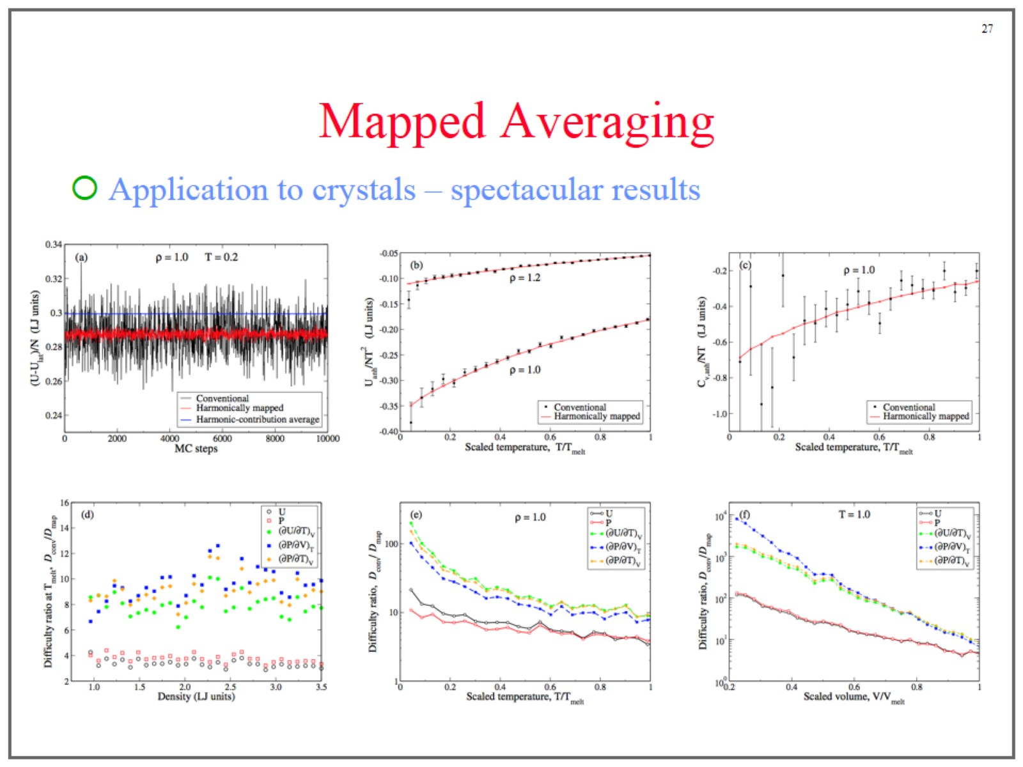
Mapped Averaging

Slide 28
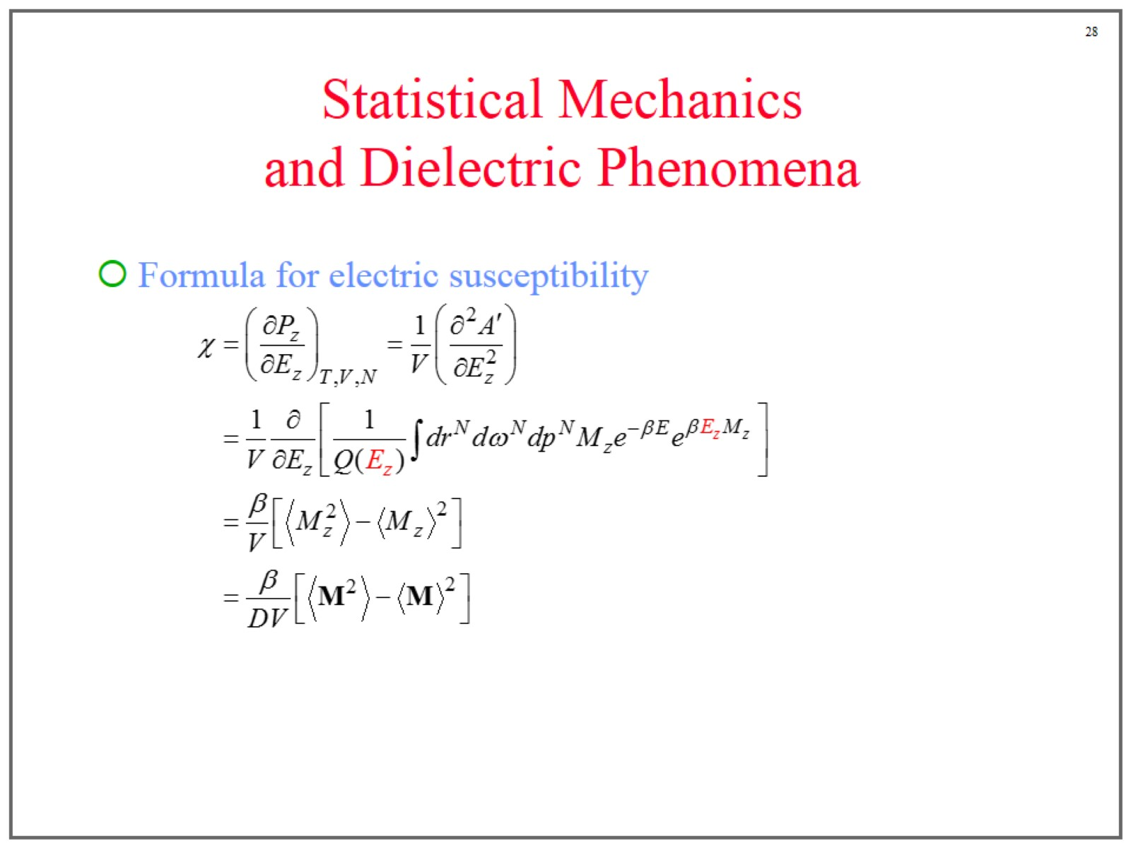
Statistical Mechanics and Dielectric Phenomena

Slide 29
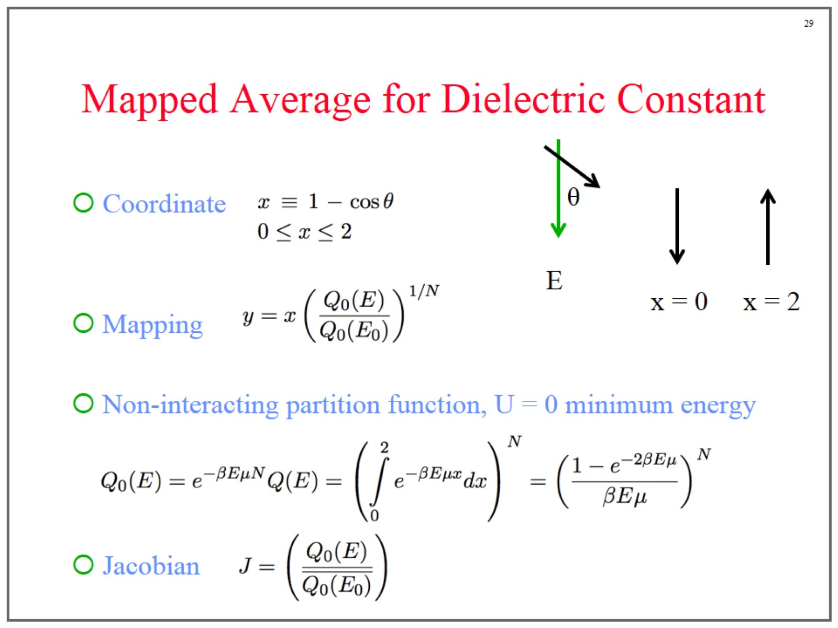
Mapped Average for Dielectric Constant

Slide 30
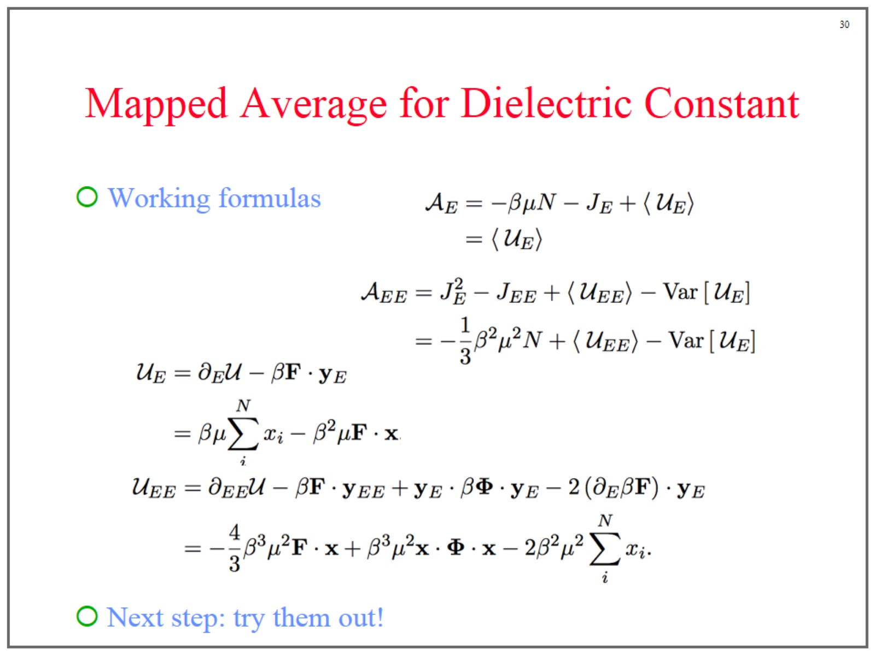
Mapped Average for Dielectric Constant

Slide 31


Slide 32
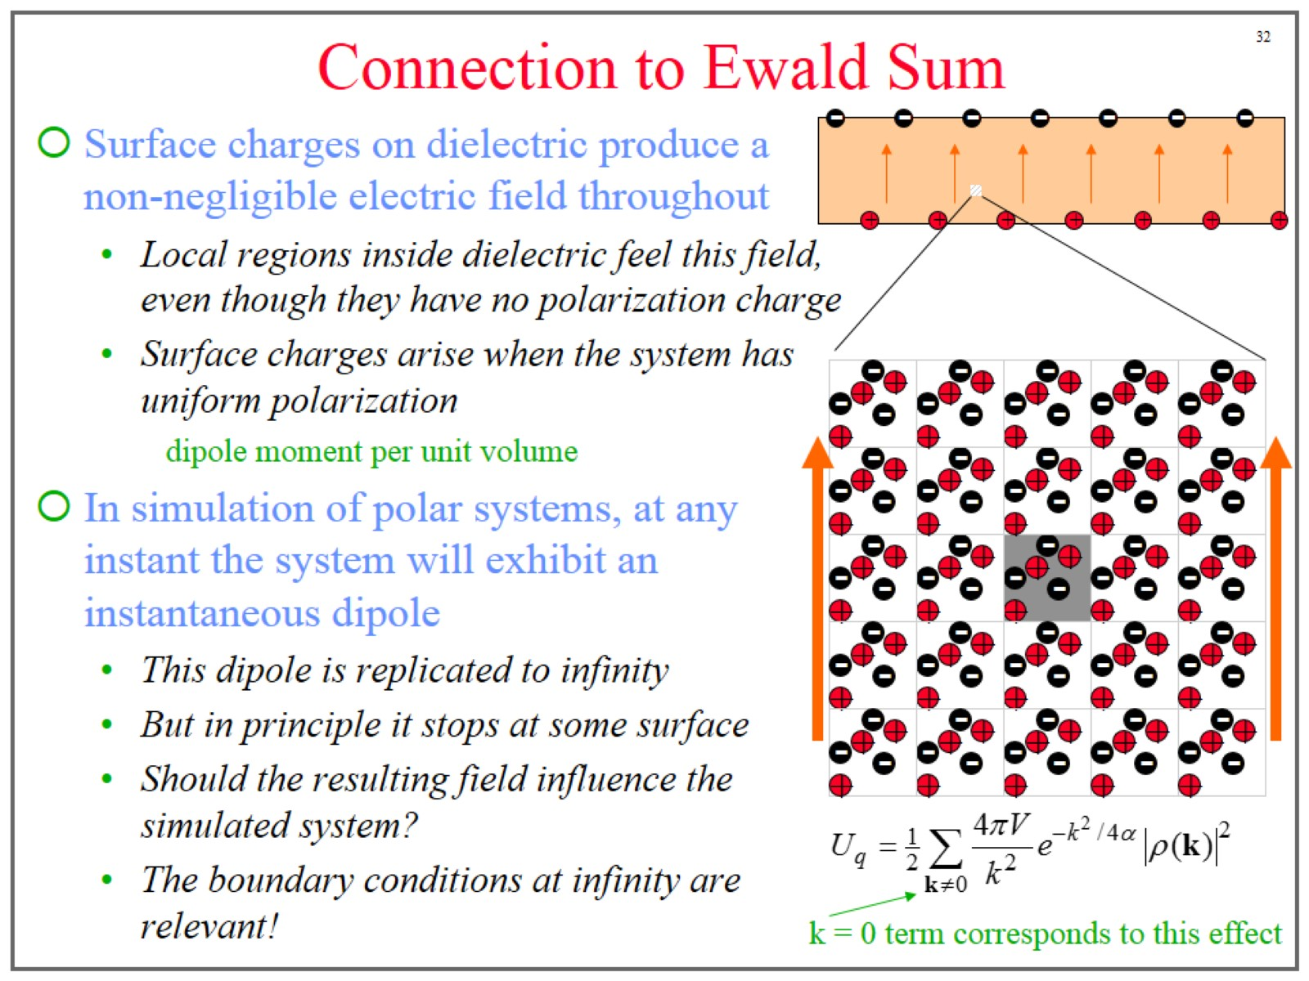
Connection to Ewald Sum

Slide 33
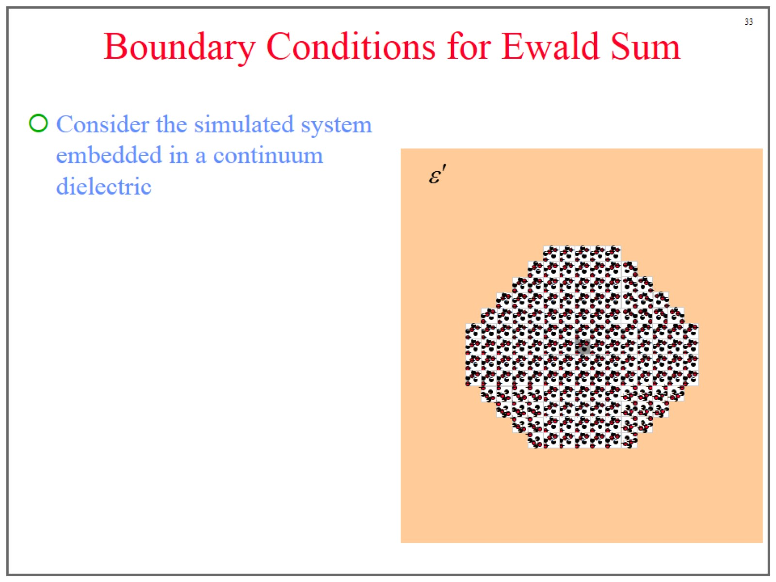
Boundary Conditions for Ewald Sum

Slide 34
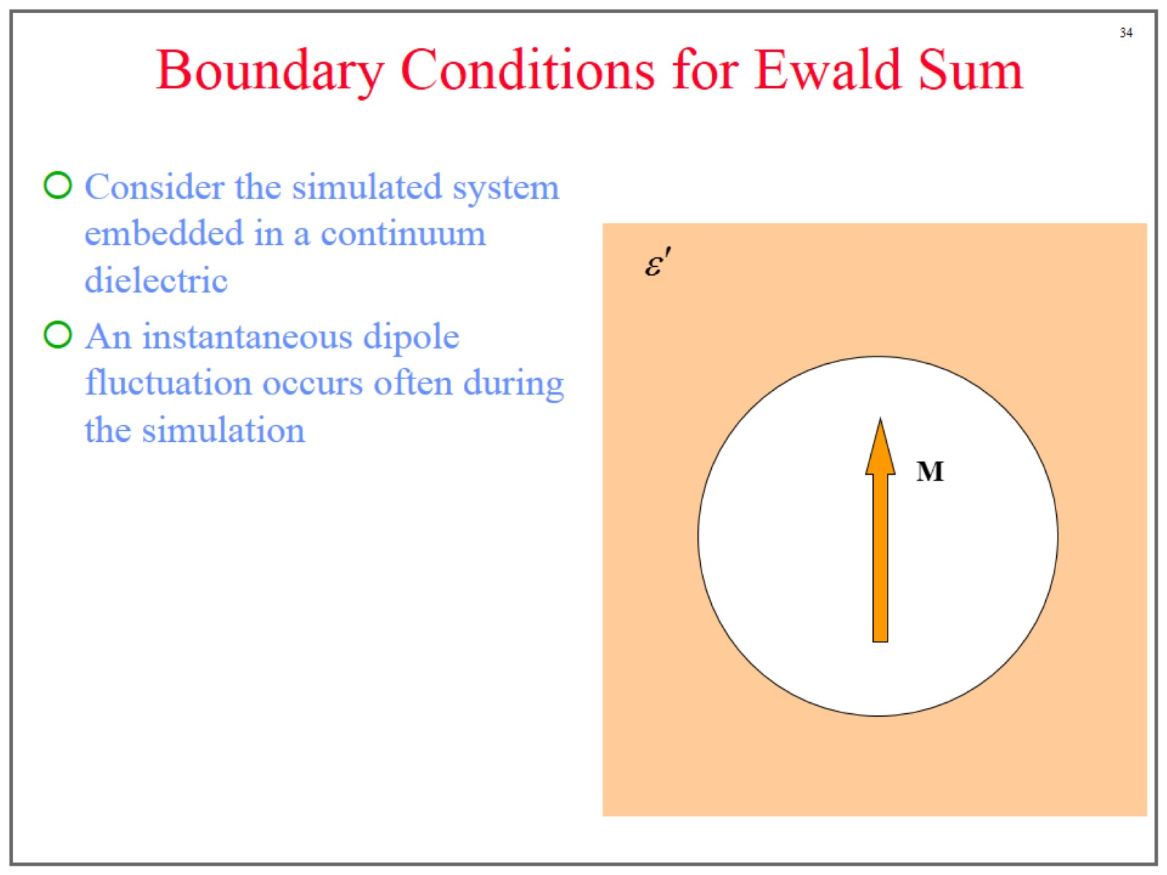
Boundary Conditions for Ewald Sum

Slide 35
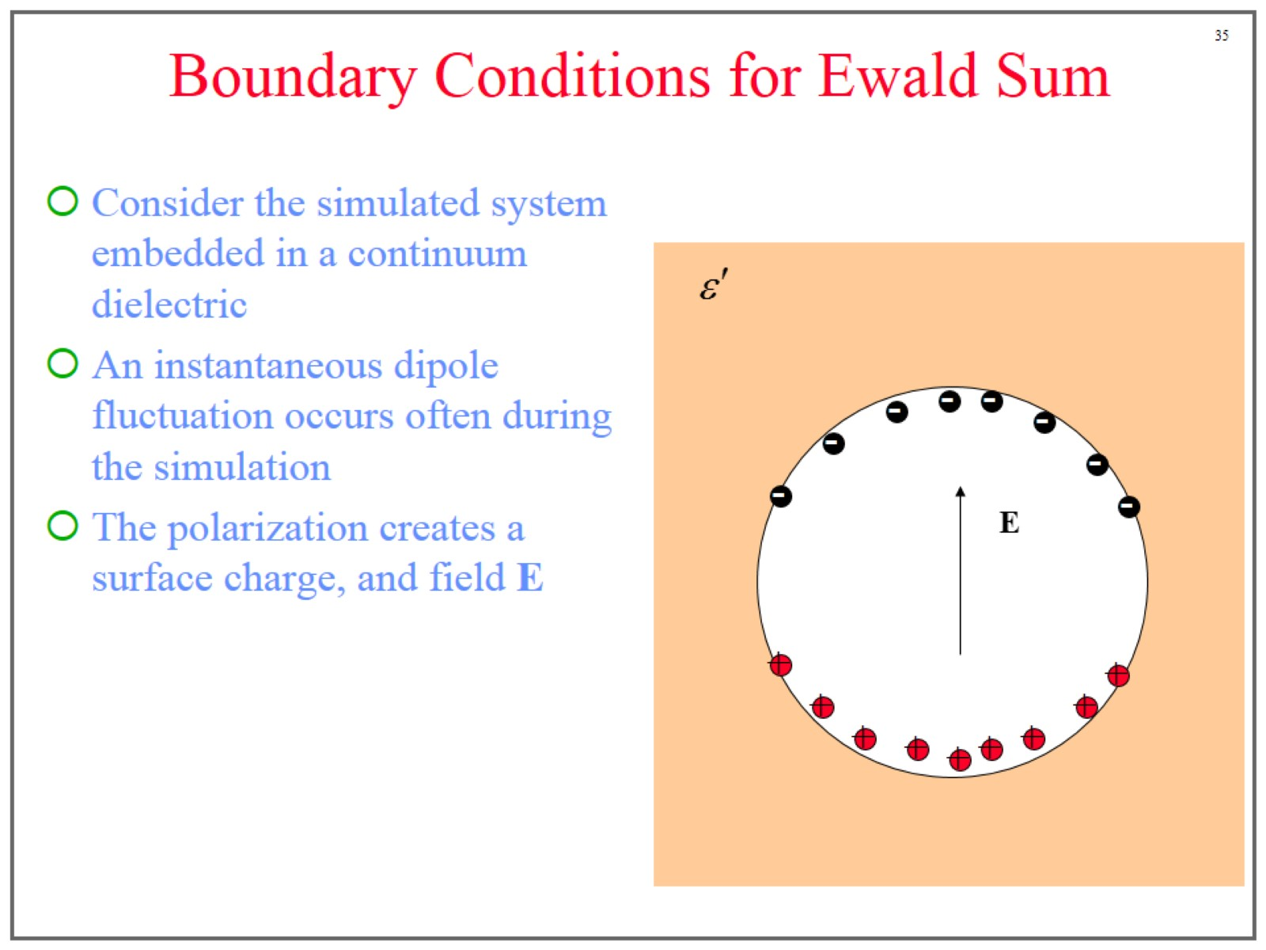
Boundary Conditions for Ewald Sum

Slide 36
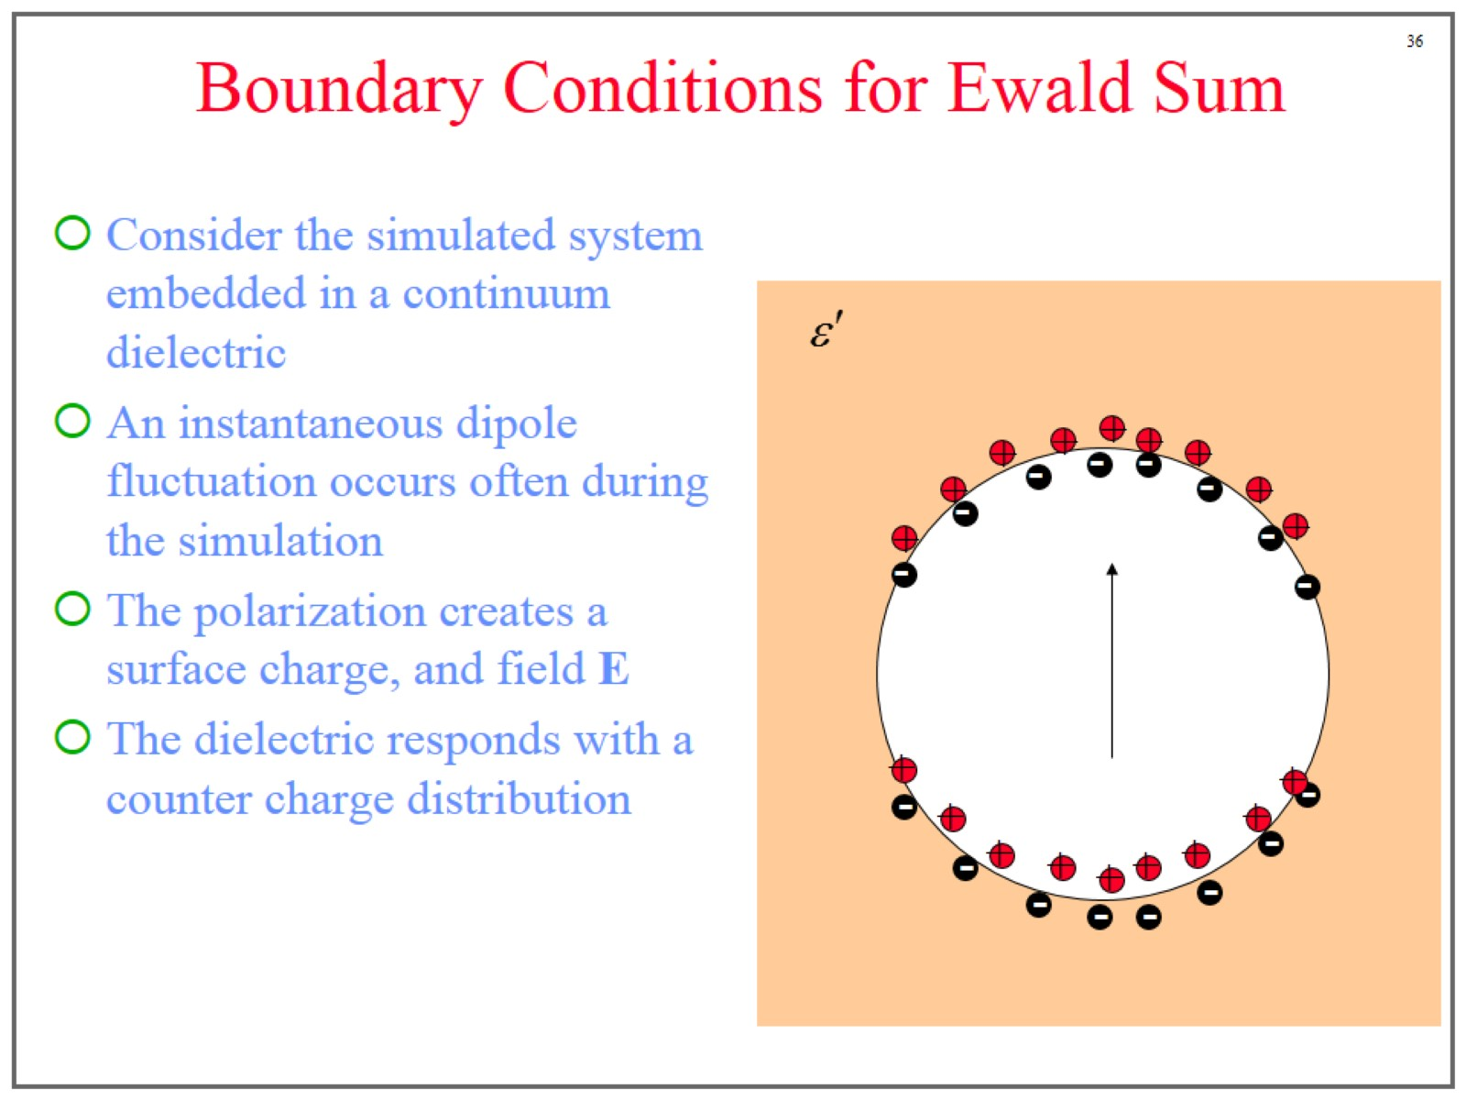
Boundary Conditions for Ewald Sum

Slide 37
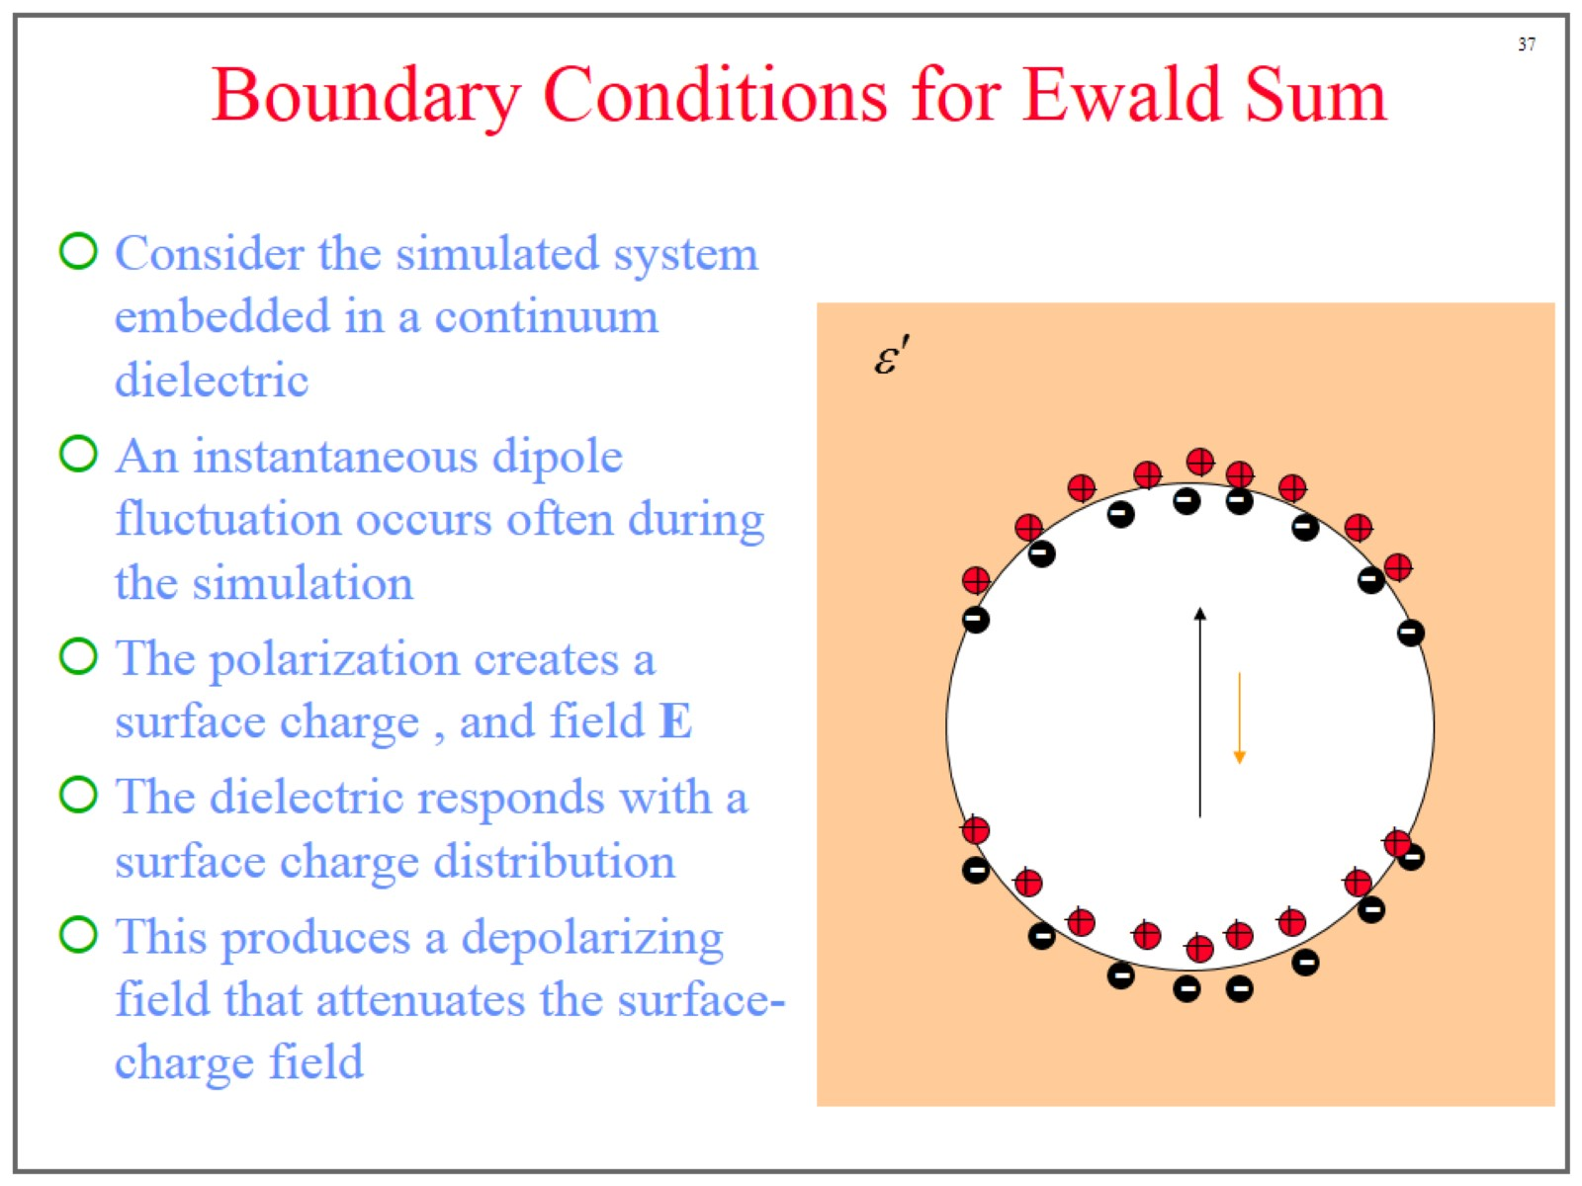
Boundary Conditions for Ewald Sum

Slide 38
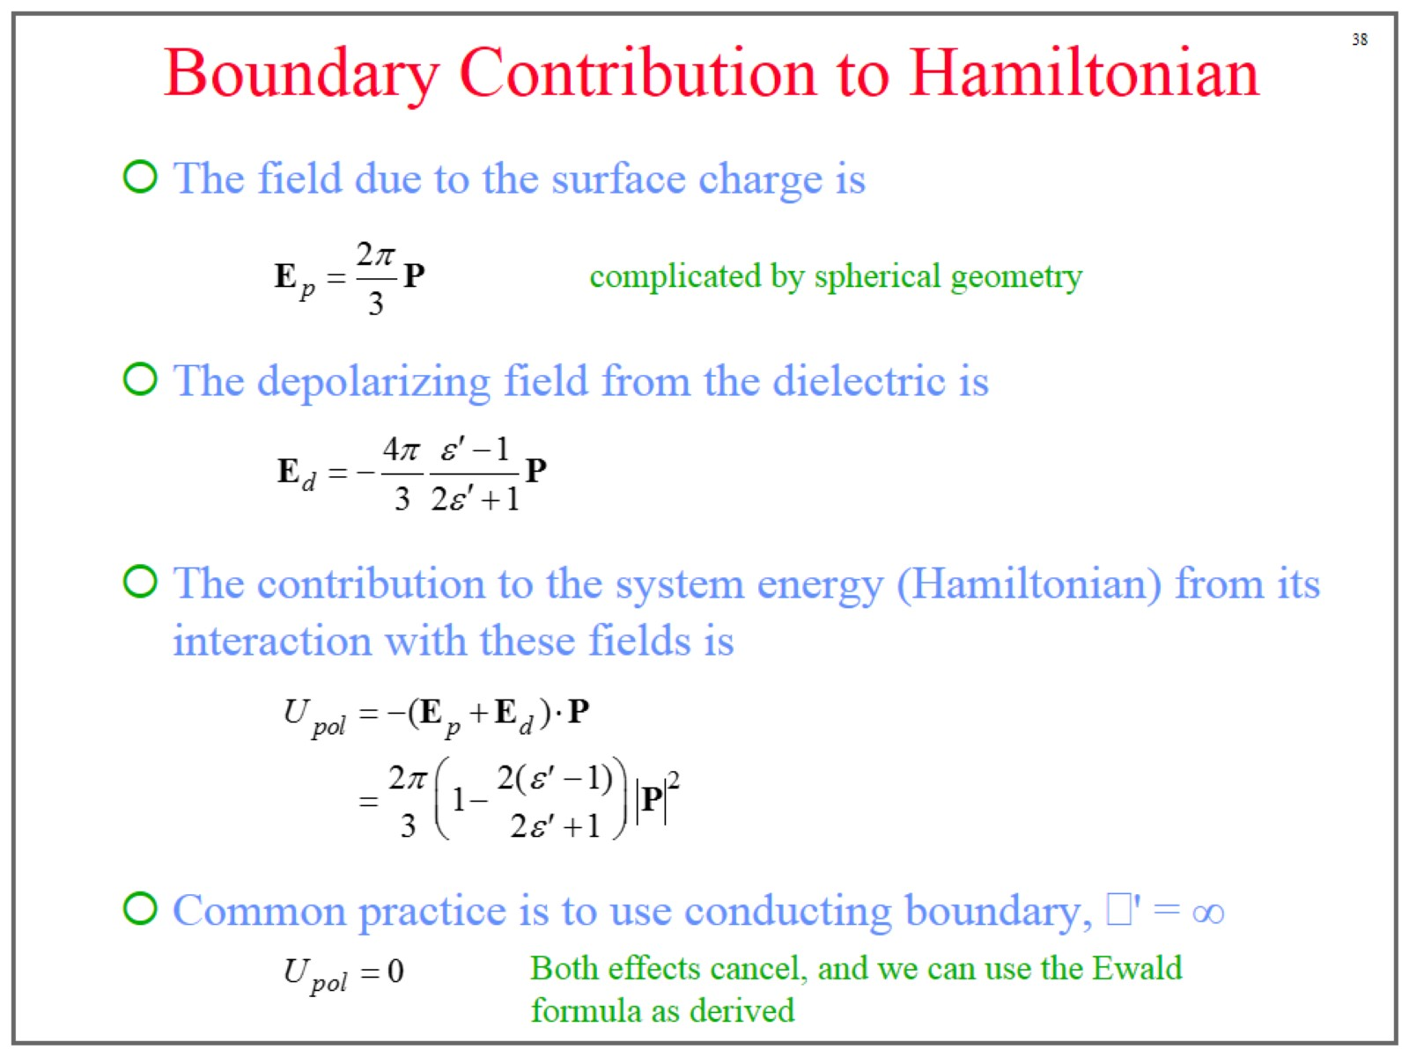
Boundary Contribution to Hamiltonian

Slide 39
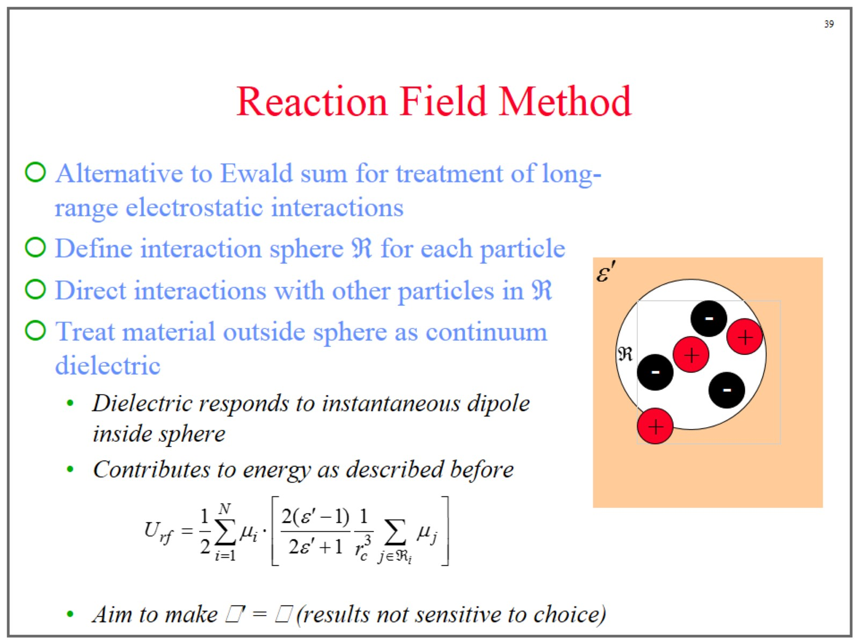
Reaction Field Method

